Slide 1

Universal Peace Federation – UK
Activities 2009

Slide 2
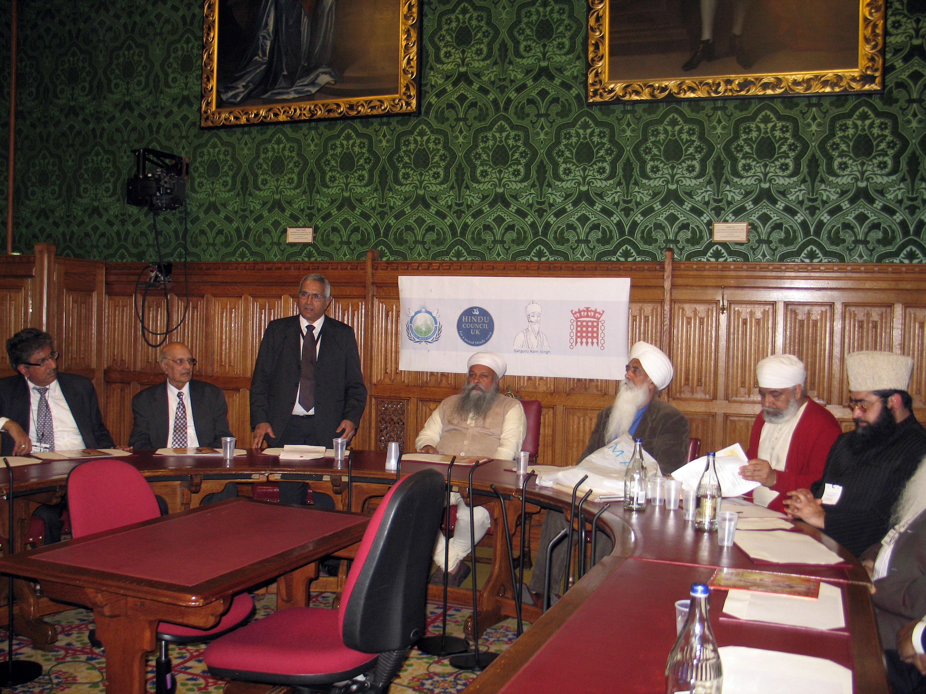
Commemorating Sat Guru Ram Singh:
Non-Violent Opposition to Oppression
Co Hosted With Hindu Council - UK

Slide 3
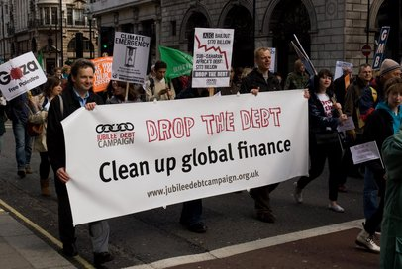
UPF Working with Partners March 29th
Jubilee Debt Campaign
Notes:
Campaigning with our partners during the G20 Summit and at the time of the Global Peace Tour.
Carrying a banner together with Nick Dearden, President of Jubilee Debt Campaign.

Slide 4
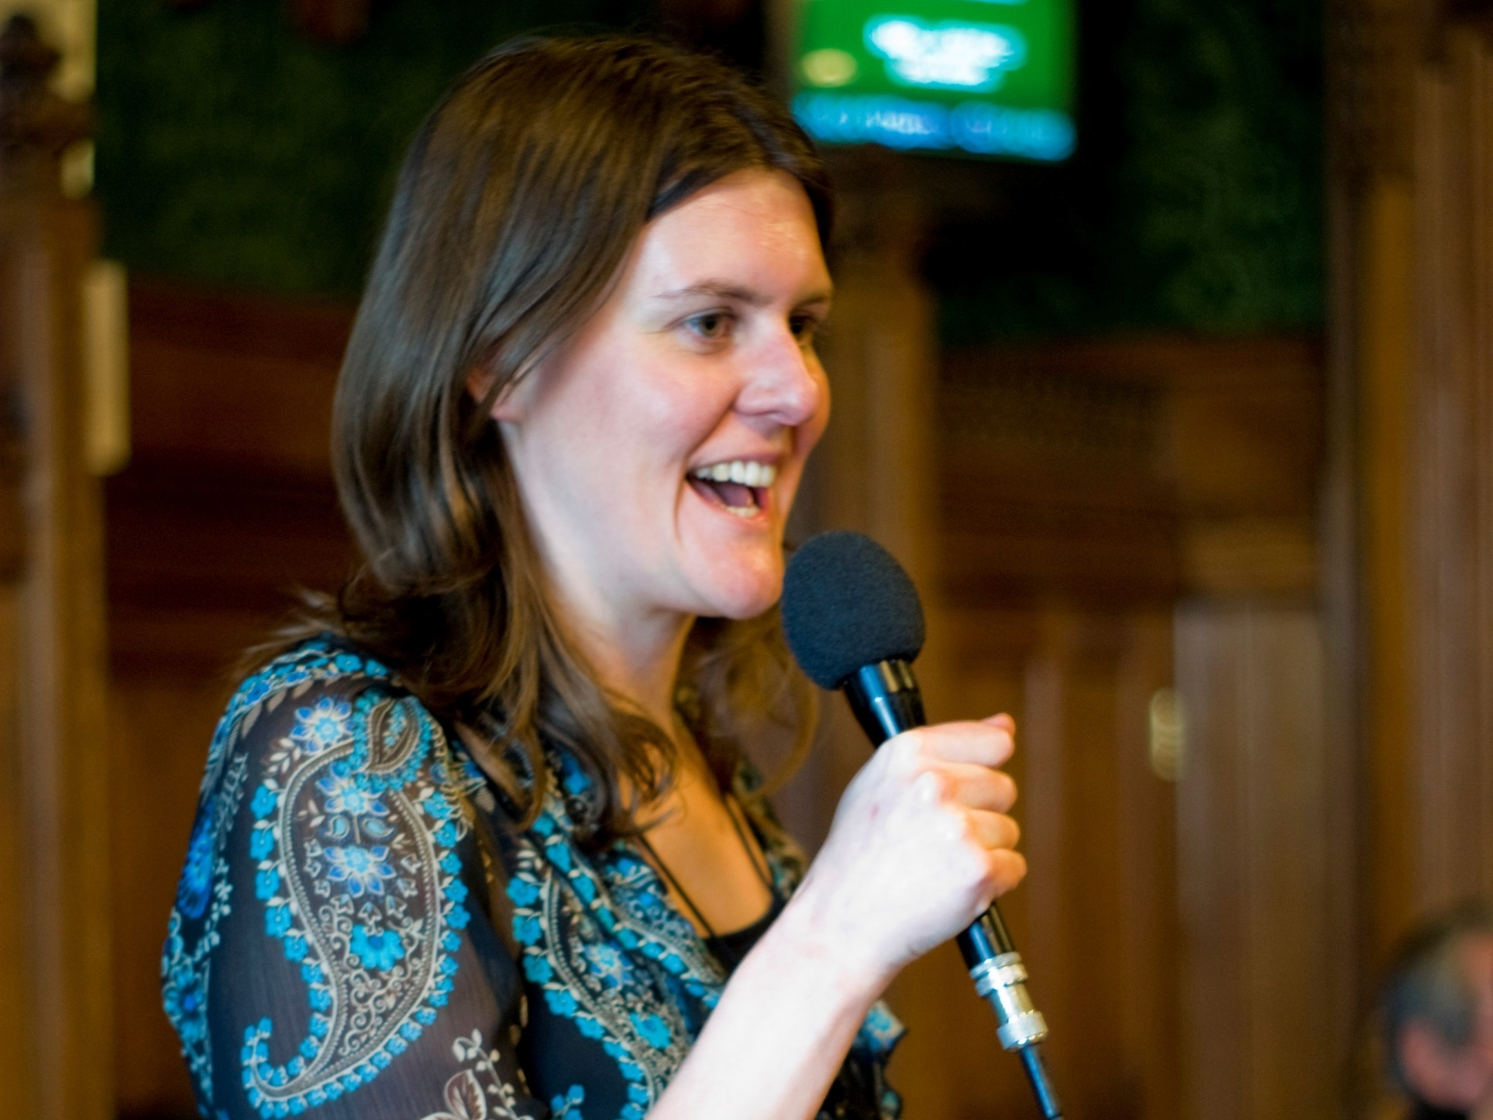
UPF UK Global Peace Tour
War on Want: Ruth Tanner
House of Commons April 2nd 2009
Notes:
Ruth Tanner is the Policy Officer of War on Want. This is a large NGO campaigning for action to help the poor all around the world. She has spoken several times on the same platform as us.

Slide 5
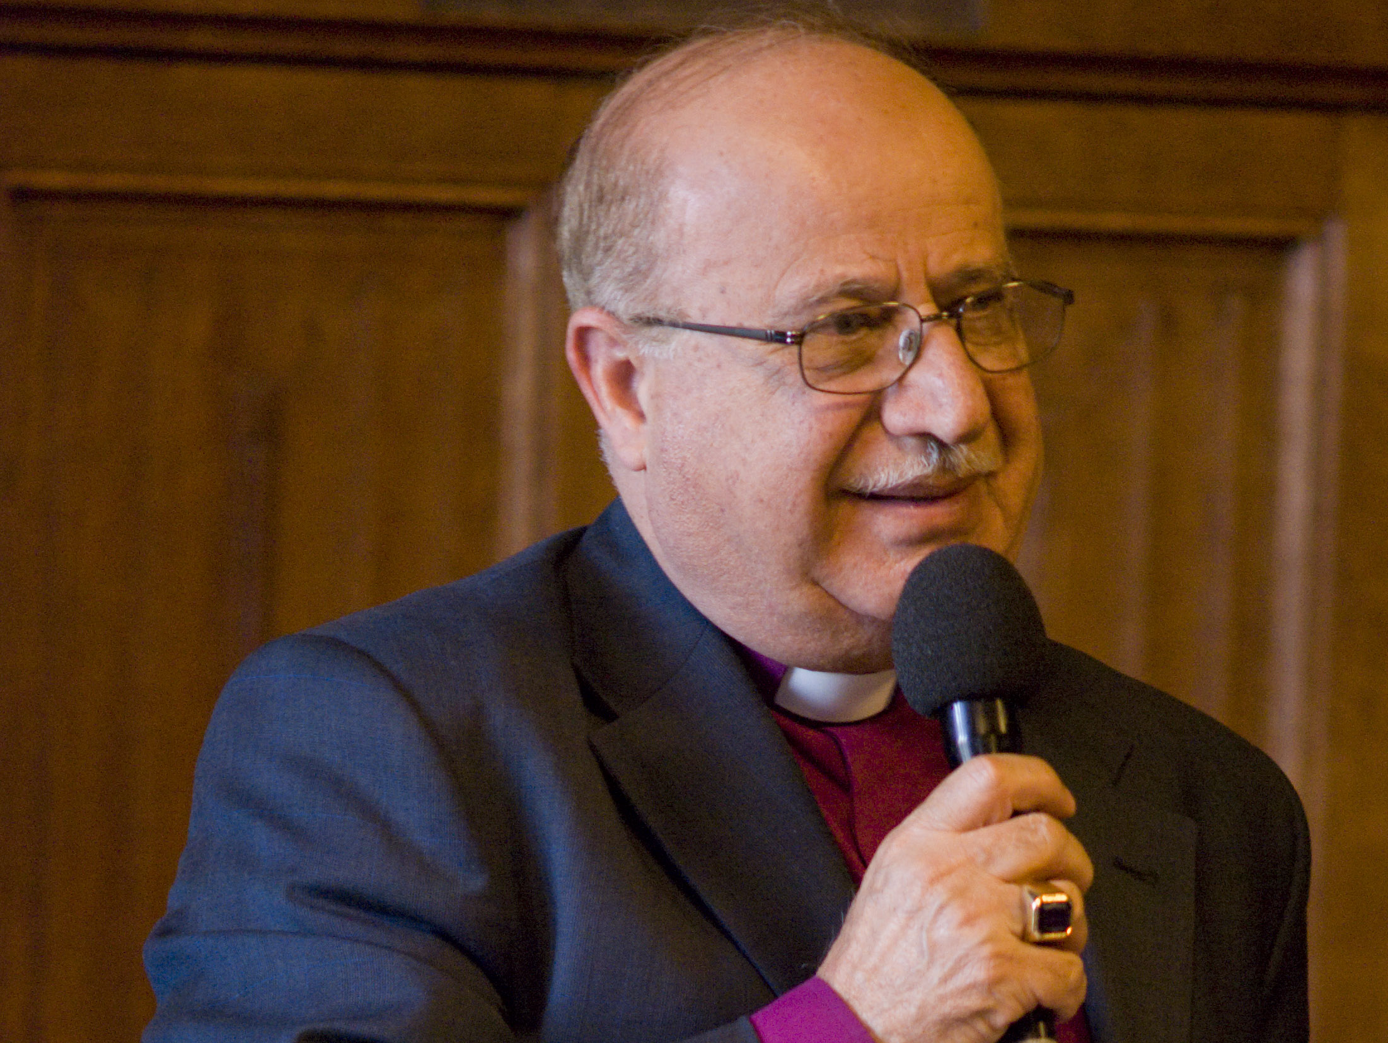
UPF UK Global Peace Tour Former Anglican Bishop of Jerusalem Rt. Rev’d Riah Abu El-Assal
House of Commons April 2nd 2009
Notes:
Bishop Riah Abu El-Assal is a good friend of ours and has helped us to get to know significant religious and political leaders.

Slide 6
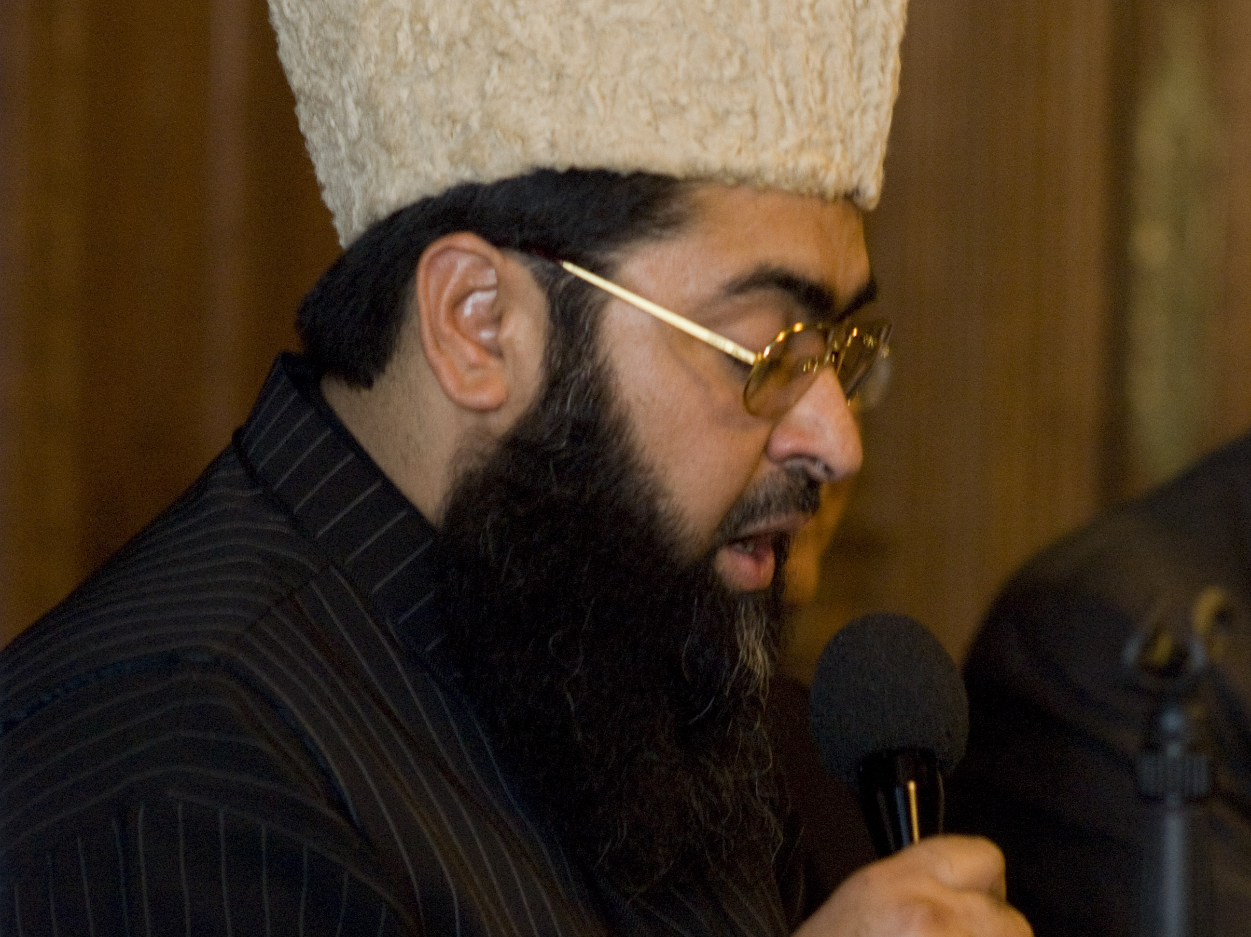
UPF Global Peace Tour Imam Umer Ilyasi
All India Imams and Mosques Organisation
April 2nd 2009

Slide 7
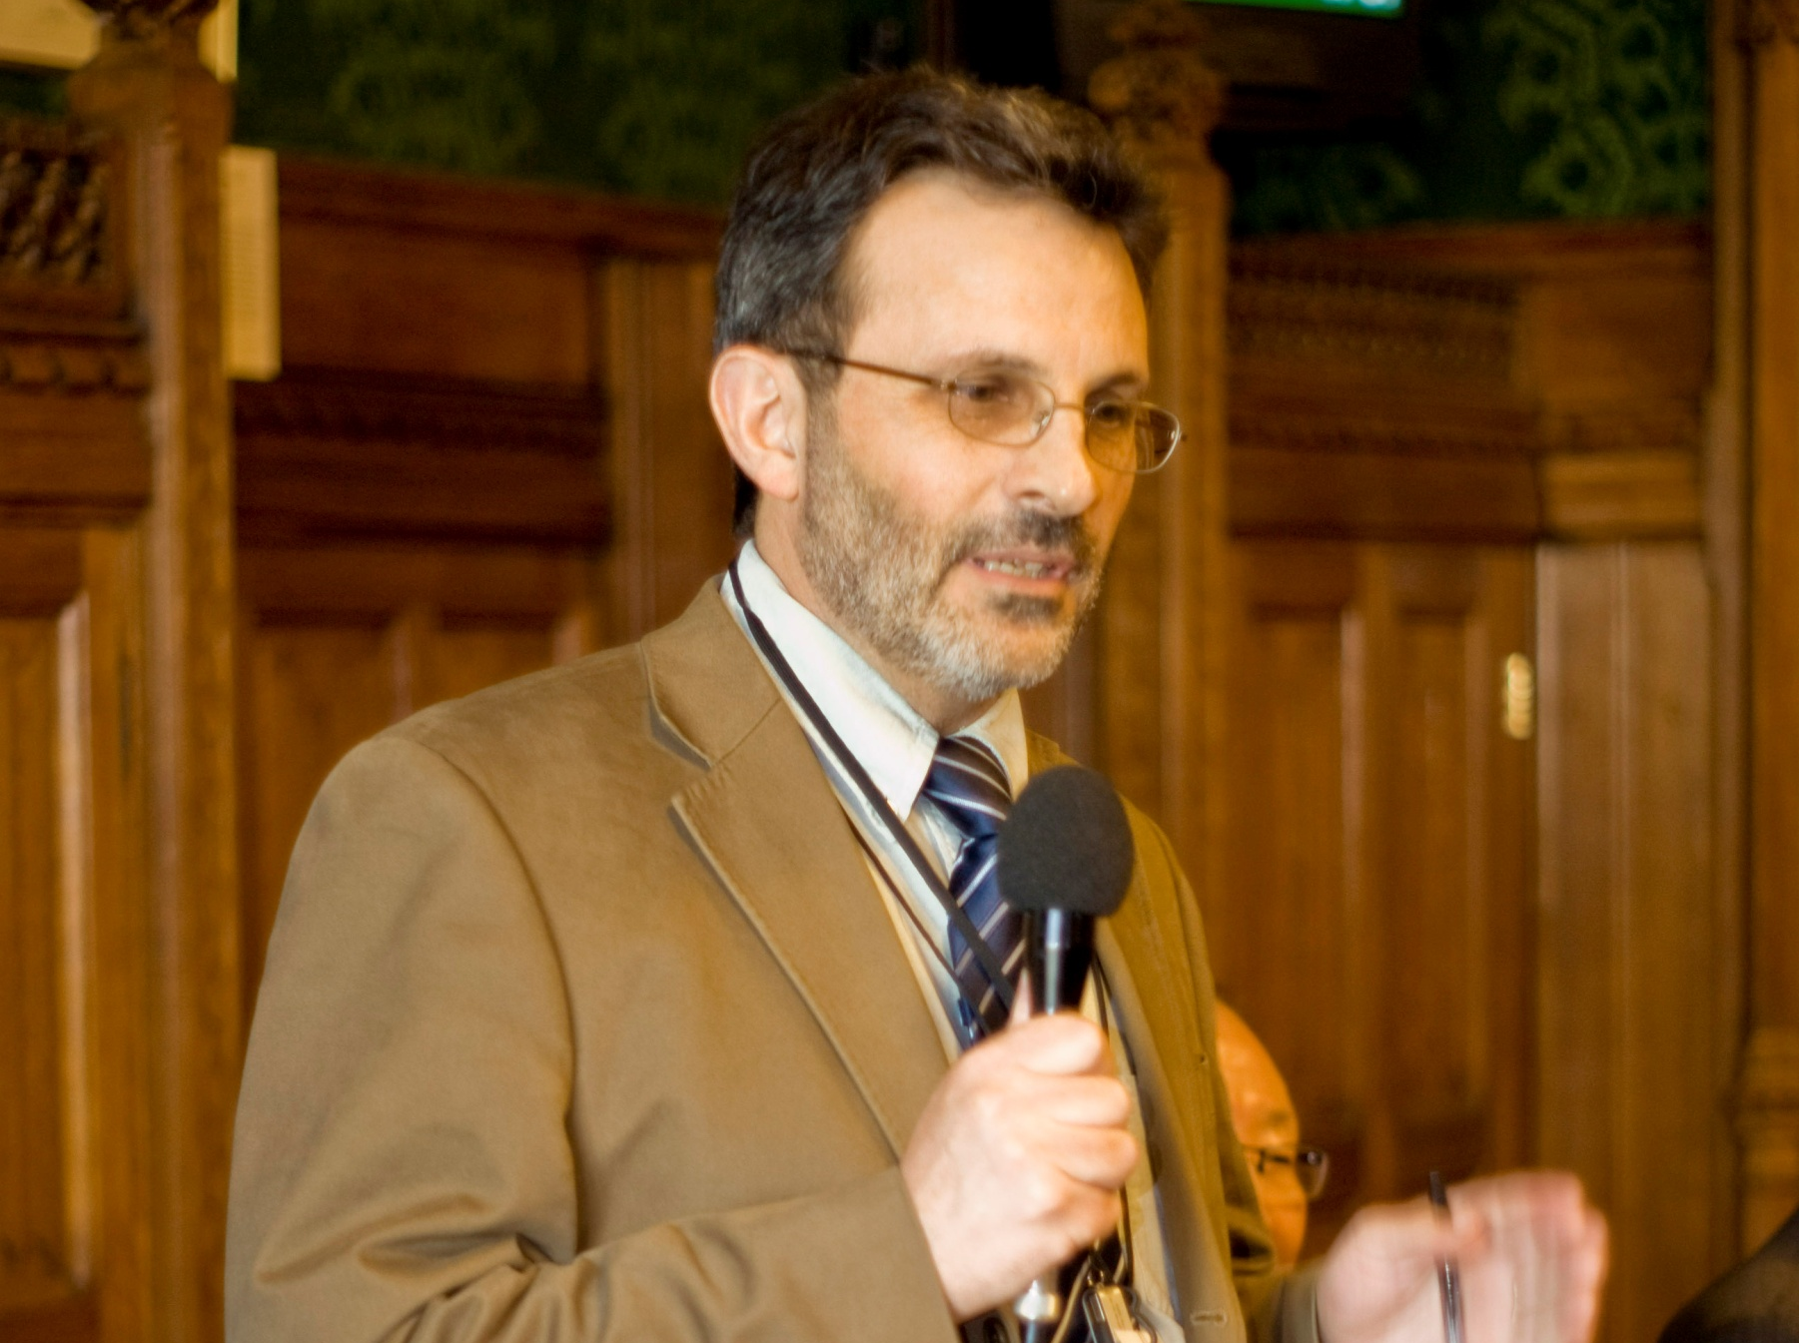
UPF Global Peace Tour Frank Kantor
URC Church and Society Secretary & Joint Public Issues Team
April 2nd 2009

Slide 8
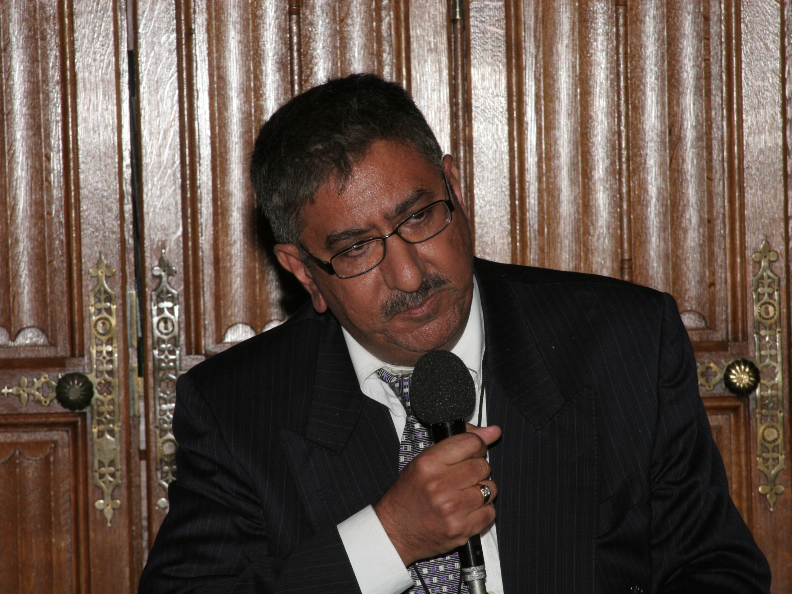
UPF Global Peace Tour Anil Bhanot
General Secretary Hindu Council – UK
April 2nd 2009

Slide 9
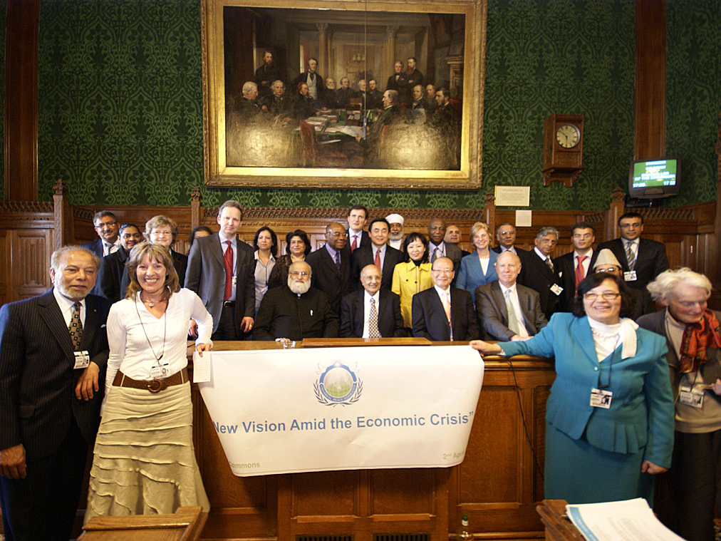
UPF UK Global Peace Tour
House of Commons April 2nd 2009

Slide 10
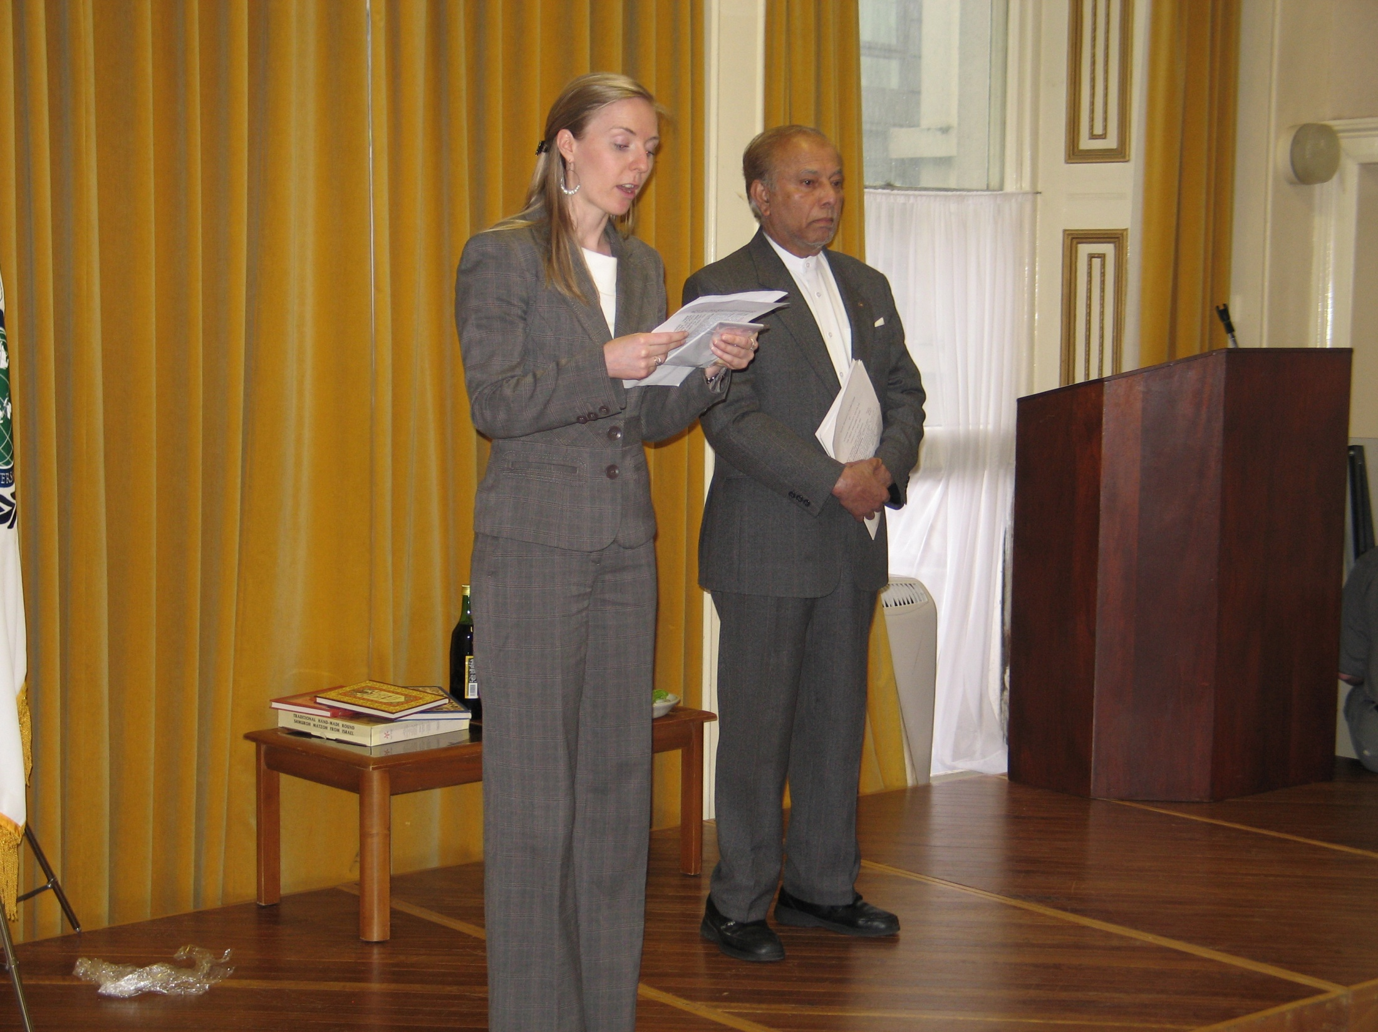
Joint Celebration: Three Abrahamic Faiths April 14th 2009

Slide 11
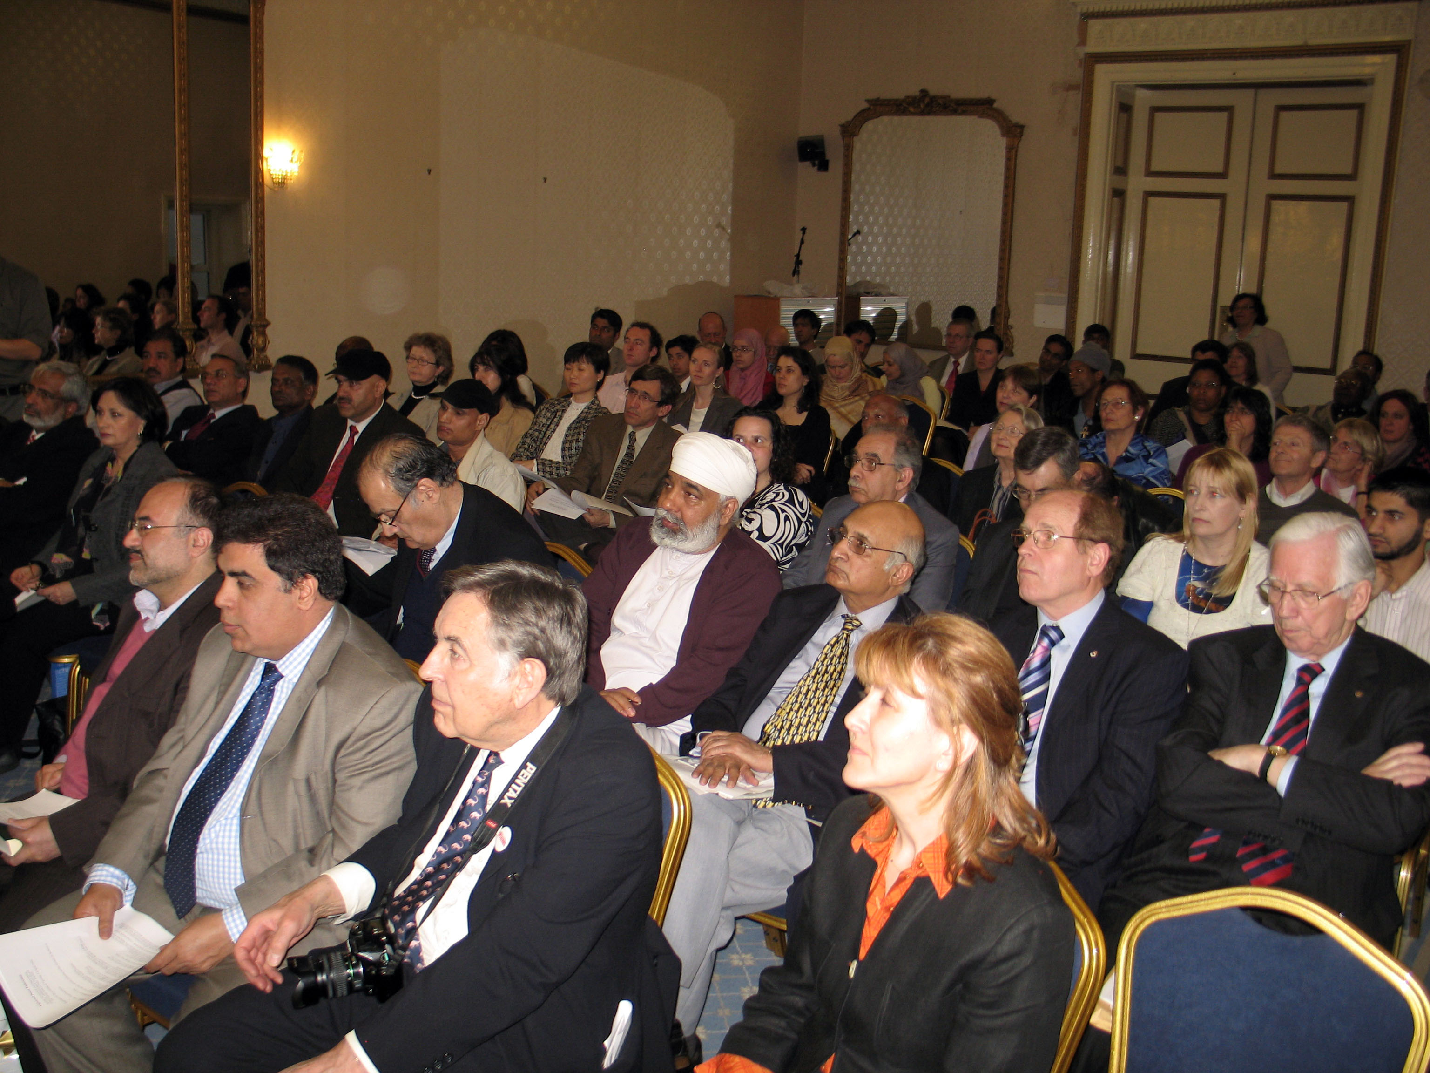
Joint Celebration: Three Abrahamic Faiths April 14th 2009

Slide 12
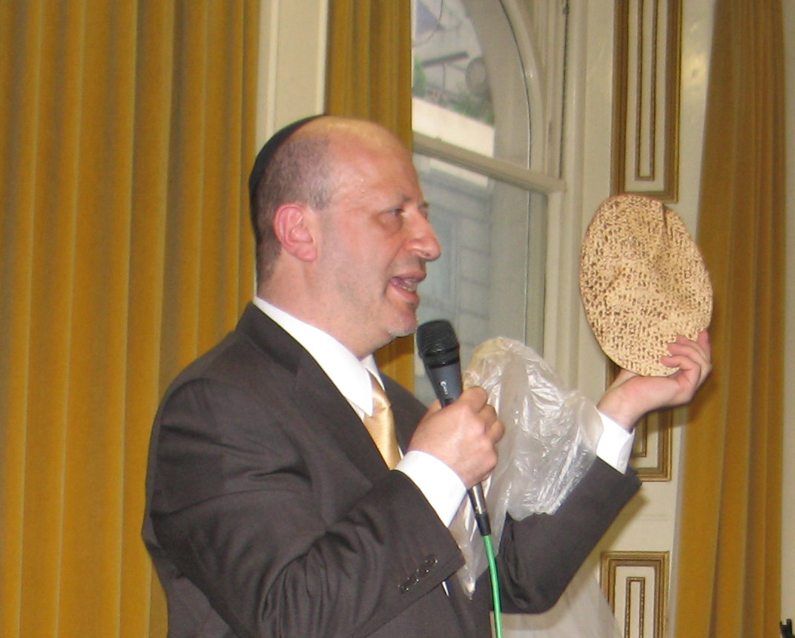
Joint Celebration: Three Abrahamic Faiths April 14th 2009

Slide 13
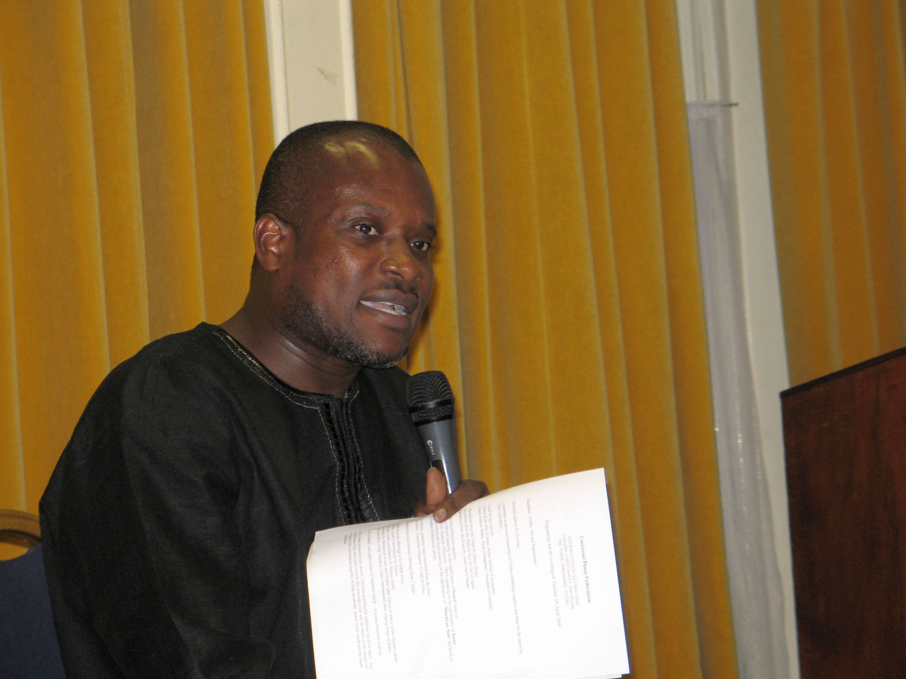
UPF UK Peace Council
July 4th 2009

Slide 14
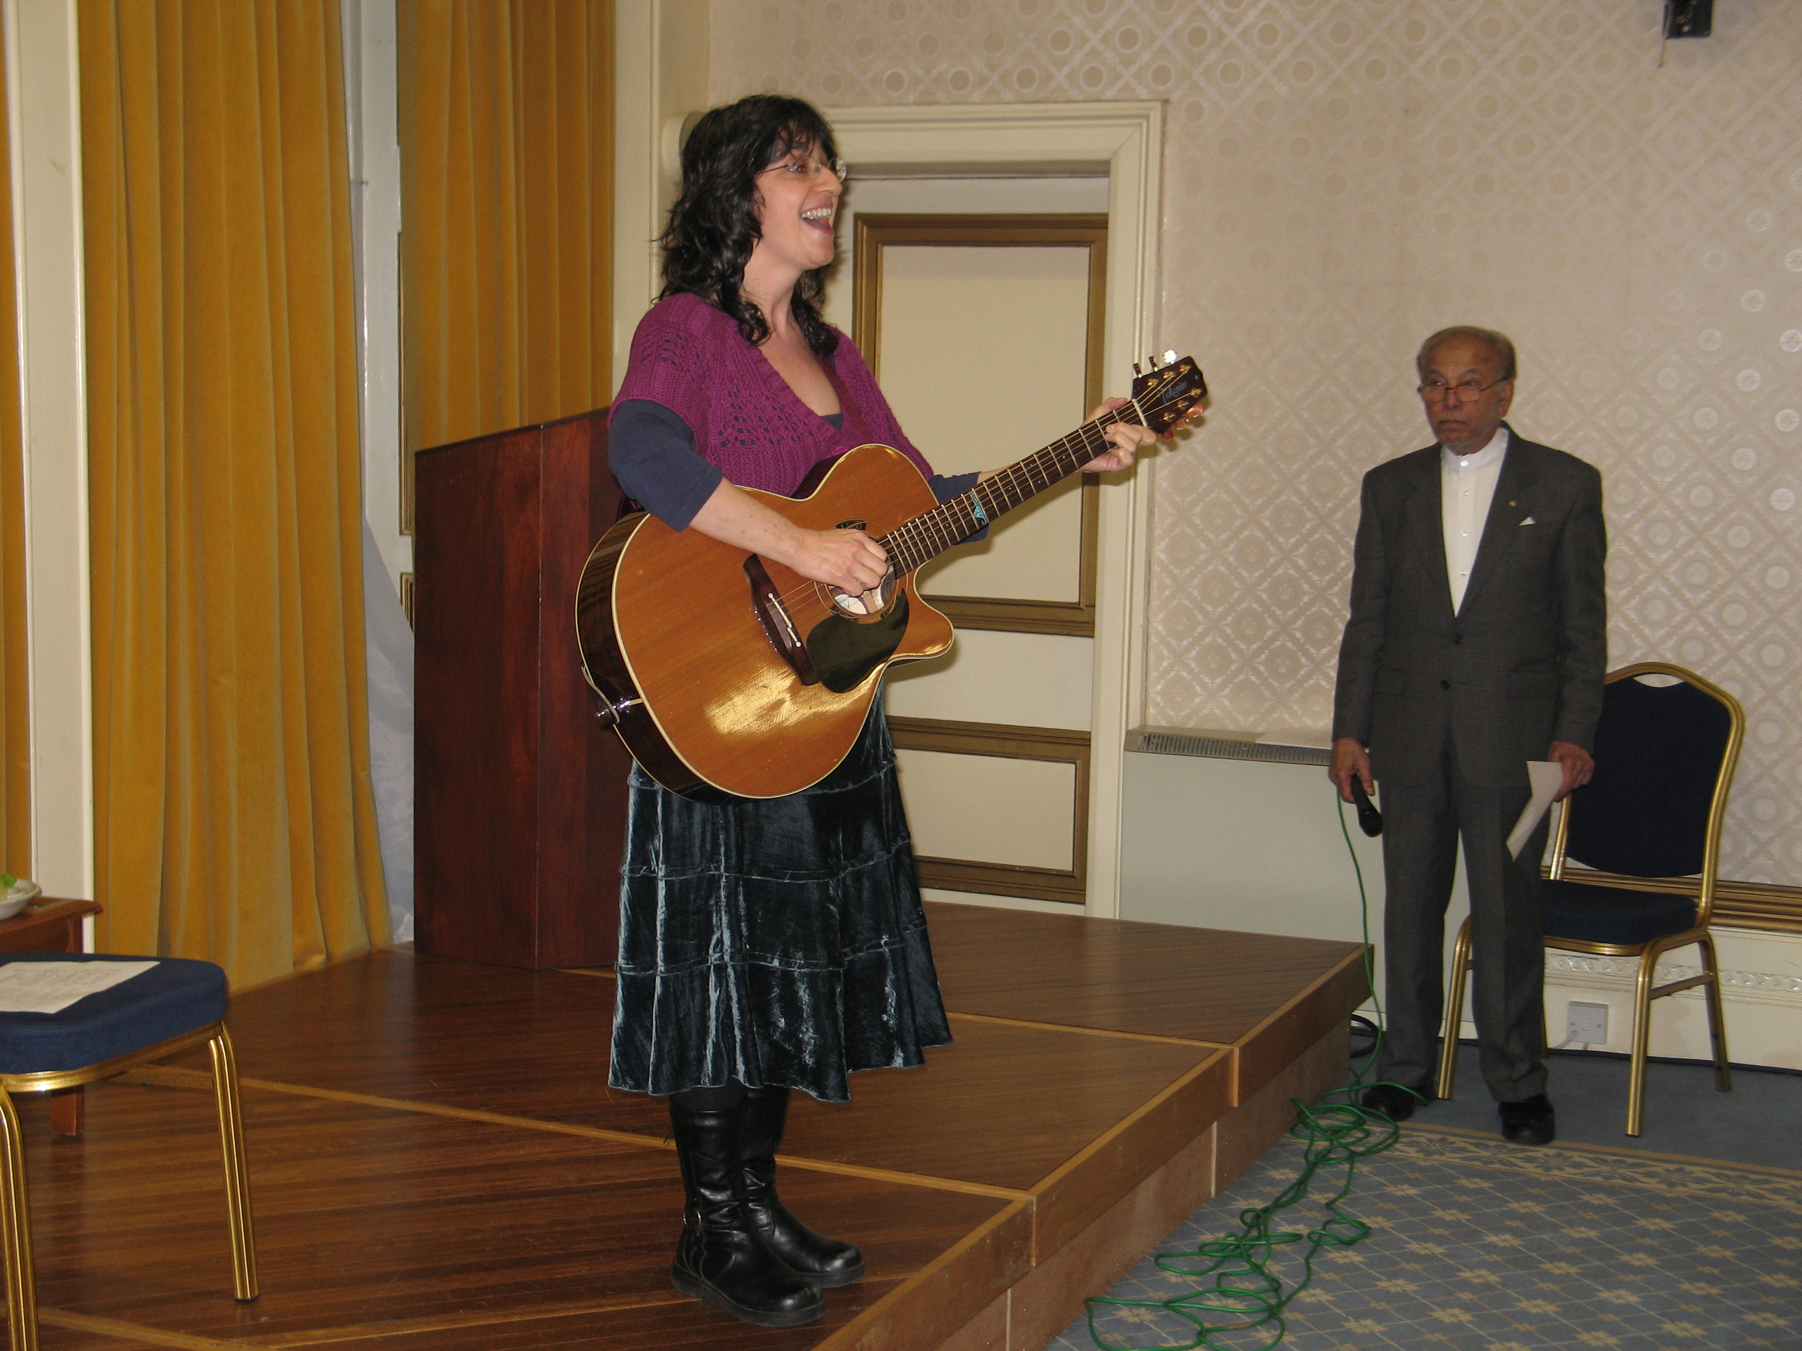

Slide 15
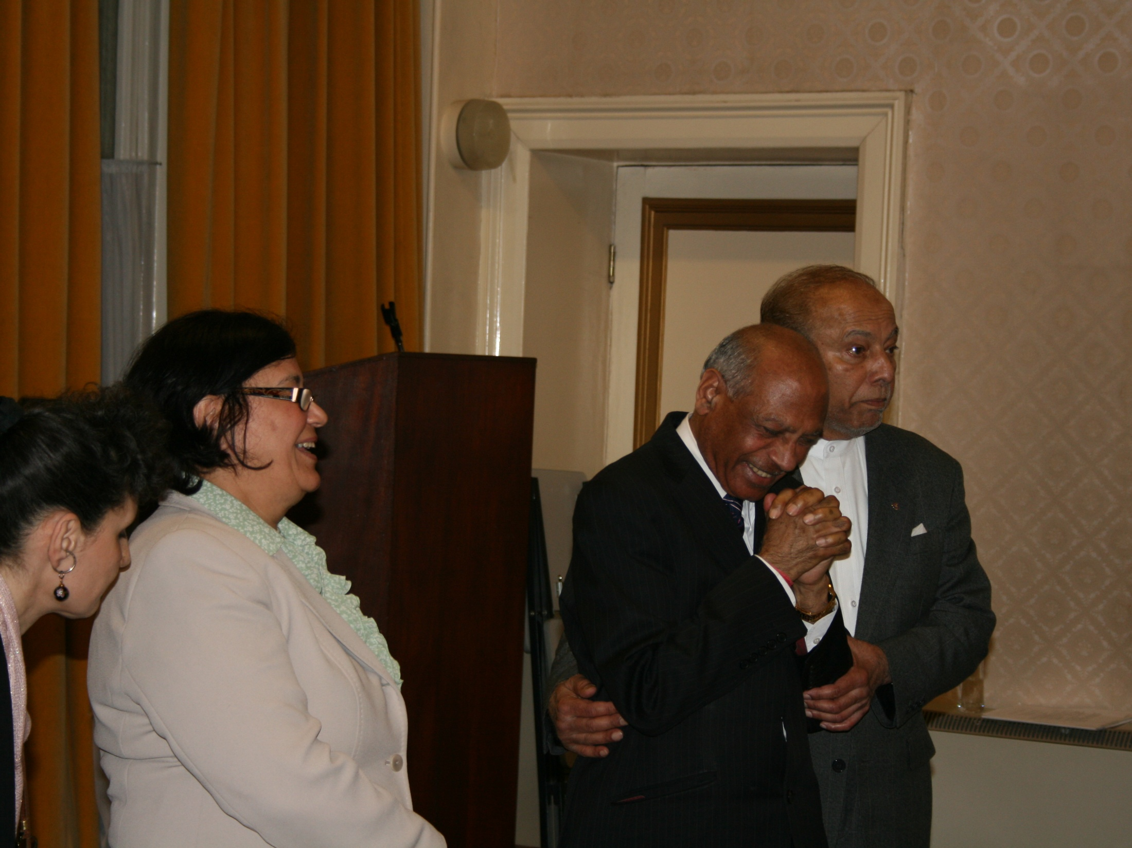
Joint Celebration: Three Abrahamic Faiths April 14th 2009

Slide 16
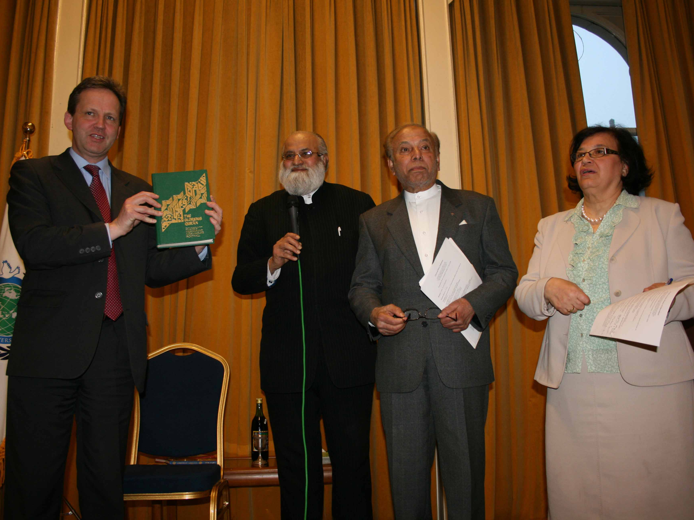
Joint Celebration: Three Abrahamic Faiths April 14th 2009

Slide 17
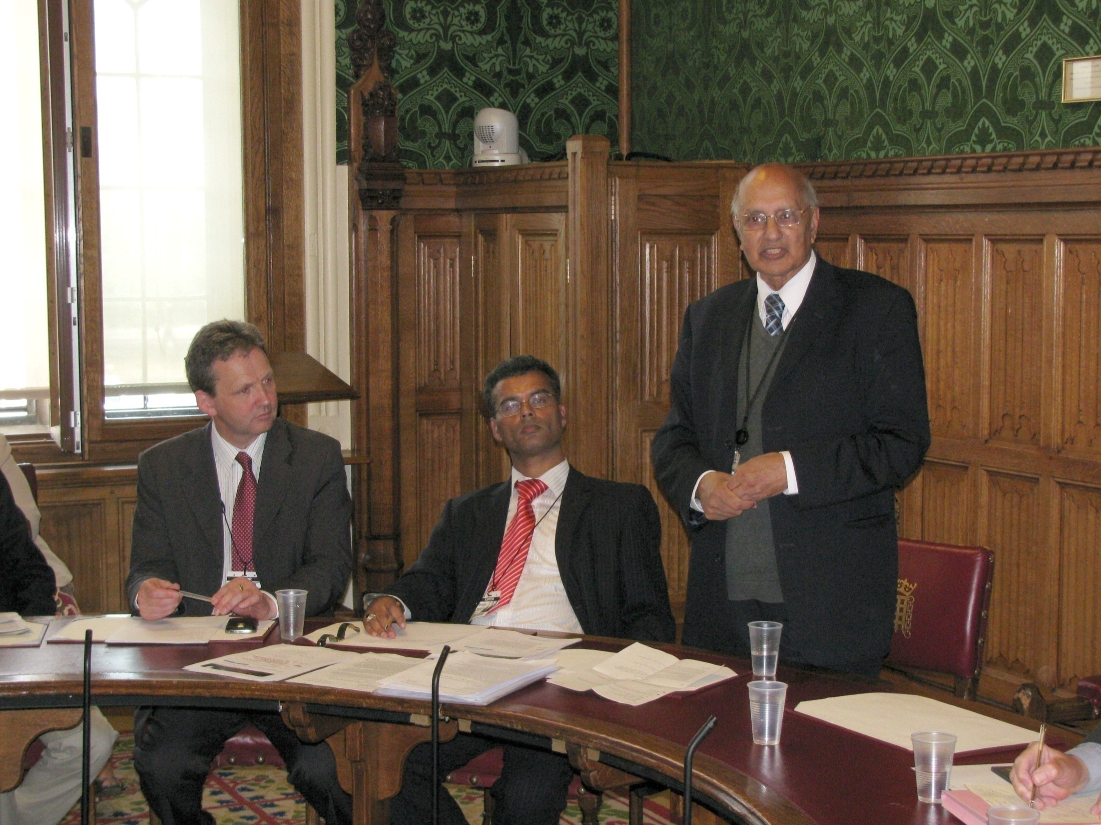
UPF UK House of Lords
Lord King - July 13th 2009
Global Economic and Financial Meltdown and the Need for a Paradigm Shift’
Notes:
UPF in partnership with Global Vision 2000 – an economic values think tank - ‘Global Economic and Financial Meltdown and the Need for a Paradigm Shift’ . Held in the House of Lords with Lord King as our host. Lord King is a Patron of UPF. He allows us to hold meetings in Parliament that are both prestigious and free. We have had approximately 20 events in Parliament now and regularly attend other group’s events in Parliament. Two Ambassadors for Peace asked us to assist them to be selected as a Lord by gaining support for their campaign from the MPs and Lords that we know well.

Slide 18
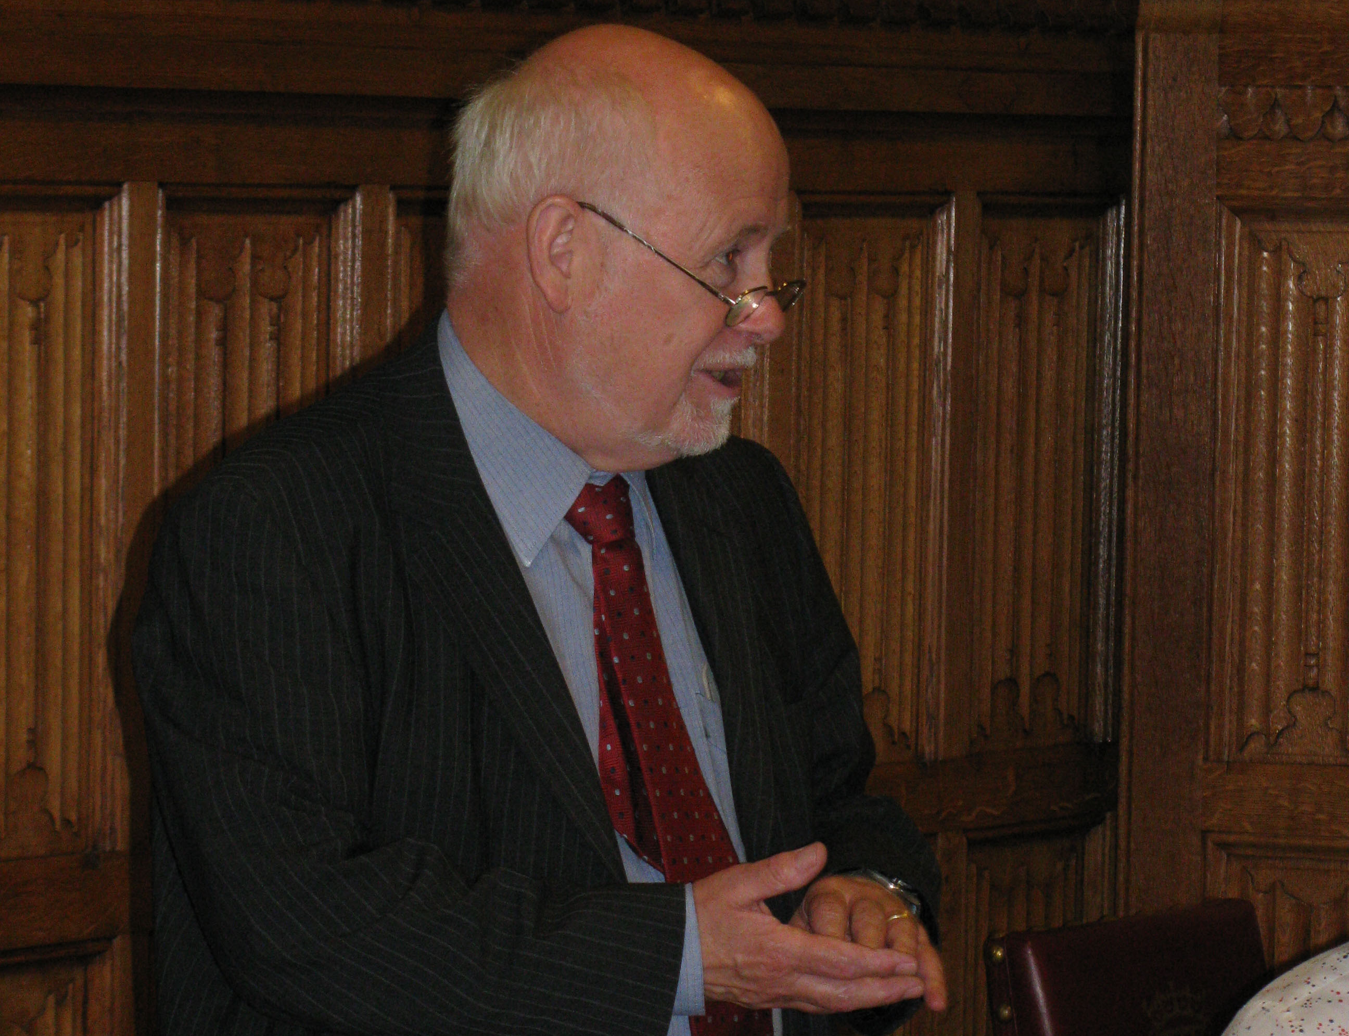
UPF UK House of Lords
Kelvin Hopkins MP - July 13th 2009
‘Global Economic and Financial Meltdown and the Need for a Paradigm Shift’
Notes:
Kelvin Hopkins MP likes our work with Millennium Development Goals and global fairness involved in the slogan ‘One Family Under God’. He got to know us through our work with other groups such as Jubilee Debt Campaign and War on Want.

Slide 19
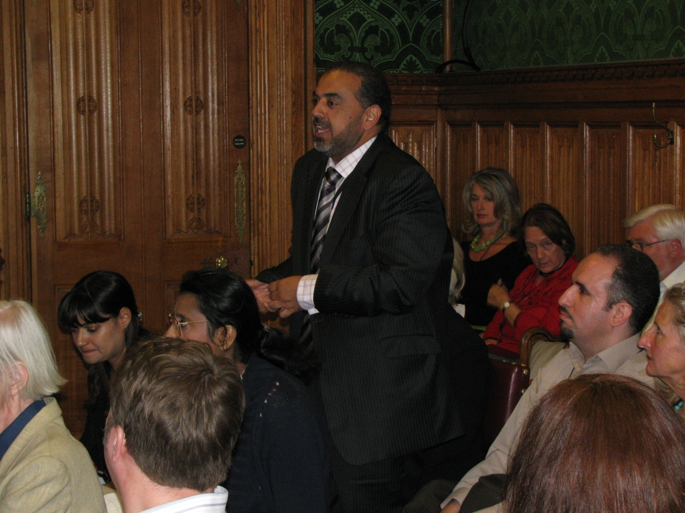
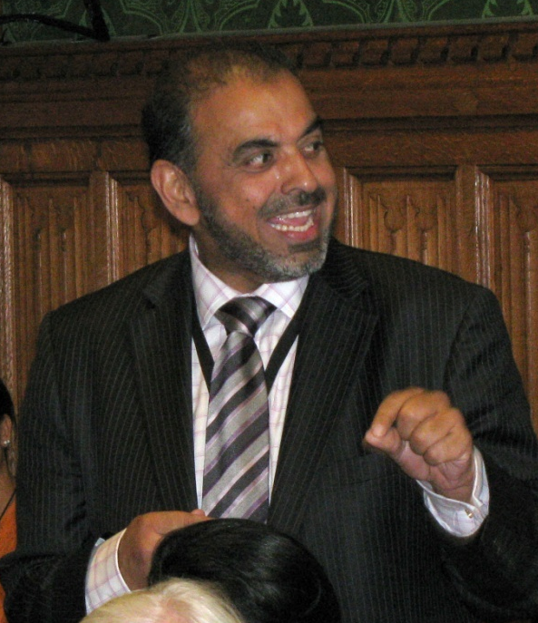
UPF UK House of Lords
Lord Ahmed - July 13th 2009
‘Global Economic and Financial Meltdown and the Need for a Paradigm Shift’
Notes:
Lord Ahmed came to listen to the speakers but was invited to speak as well.

Slide 20
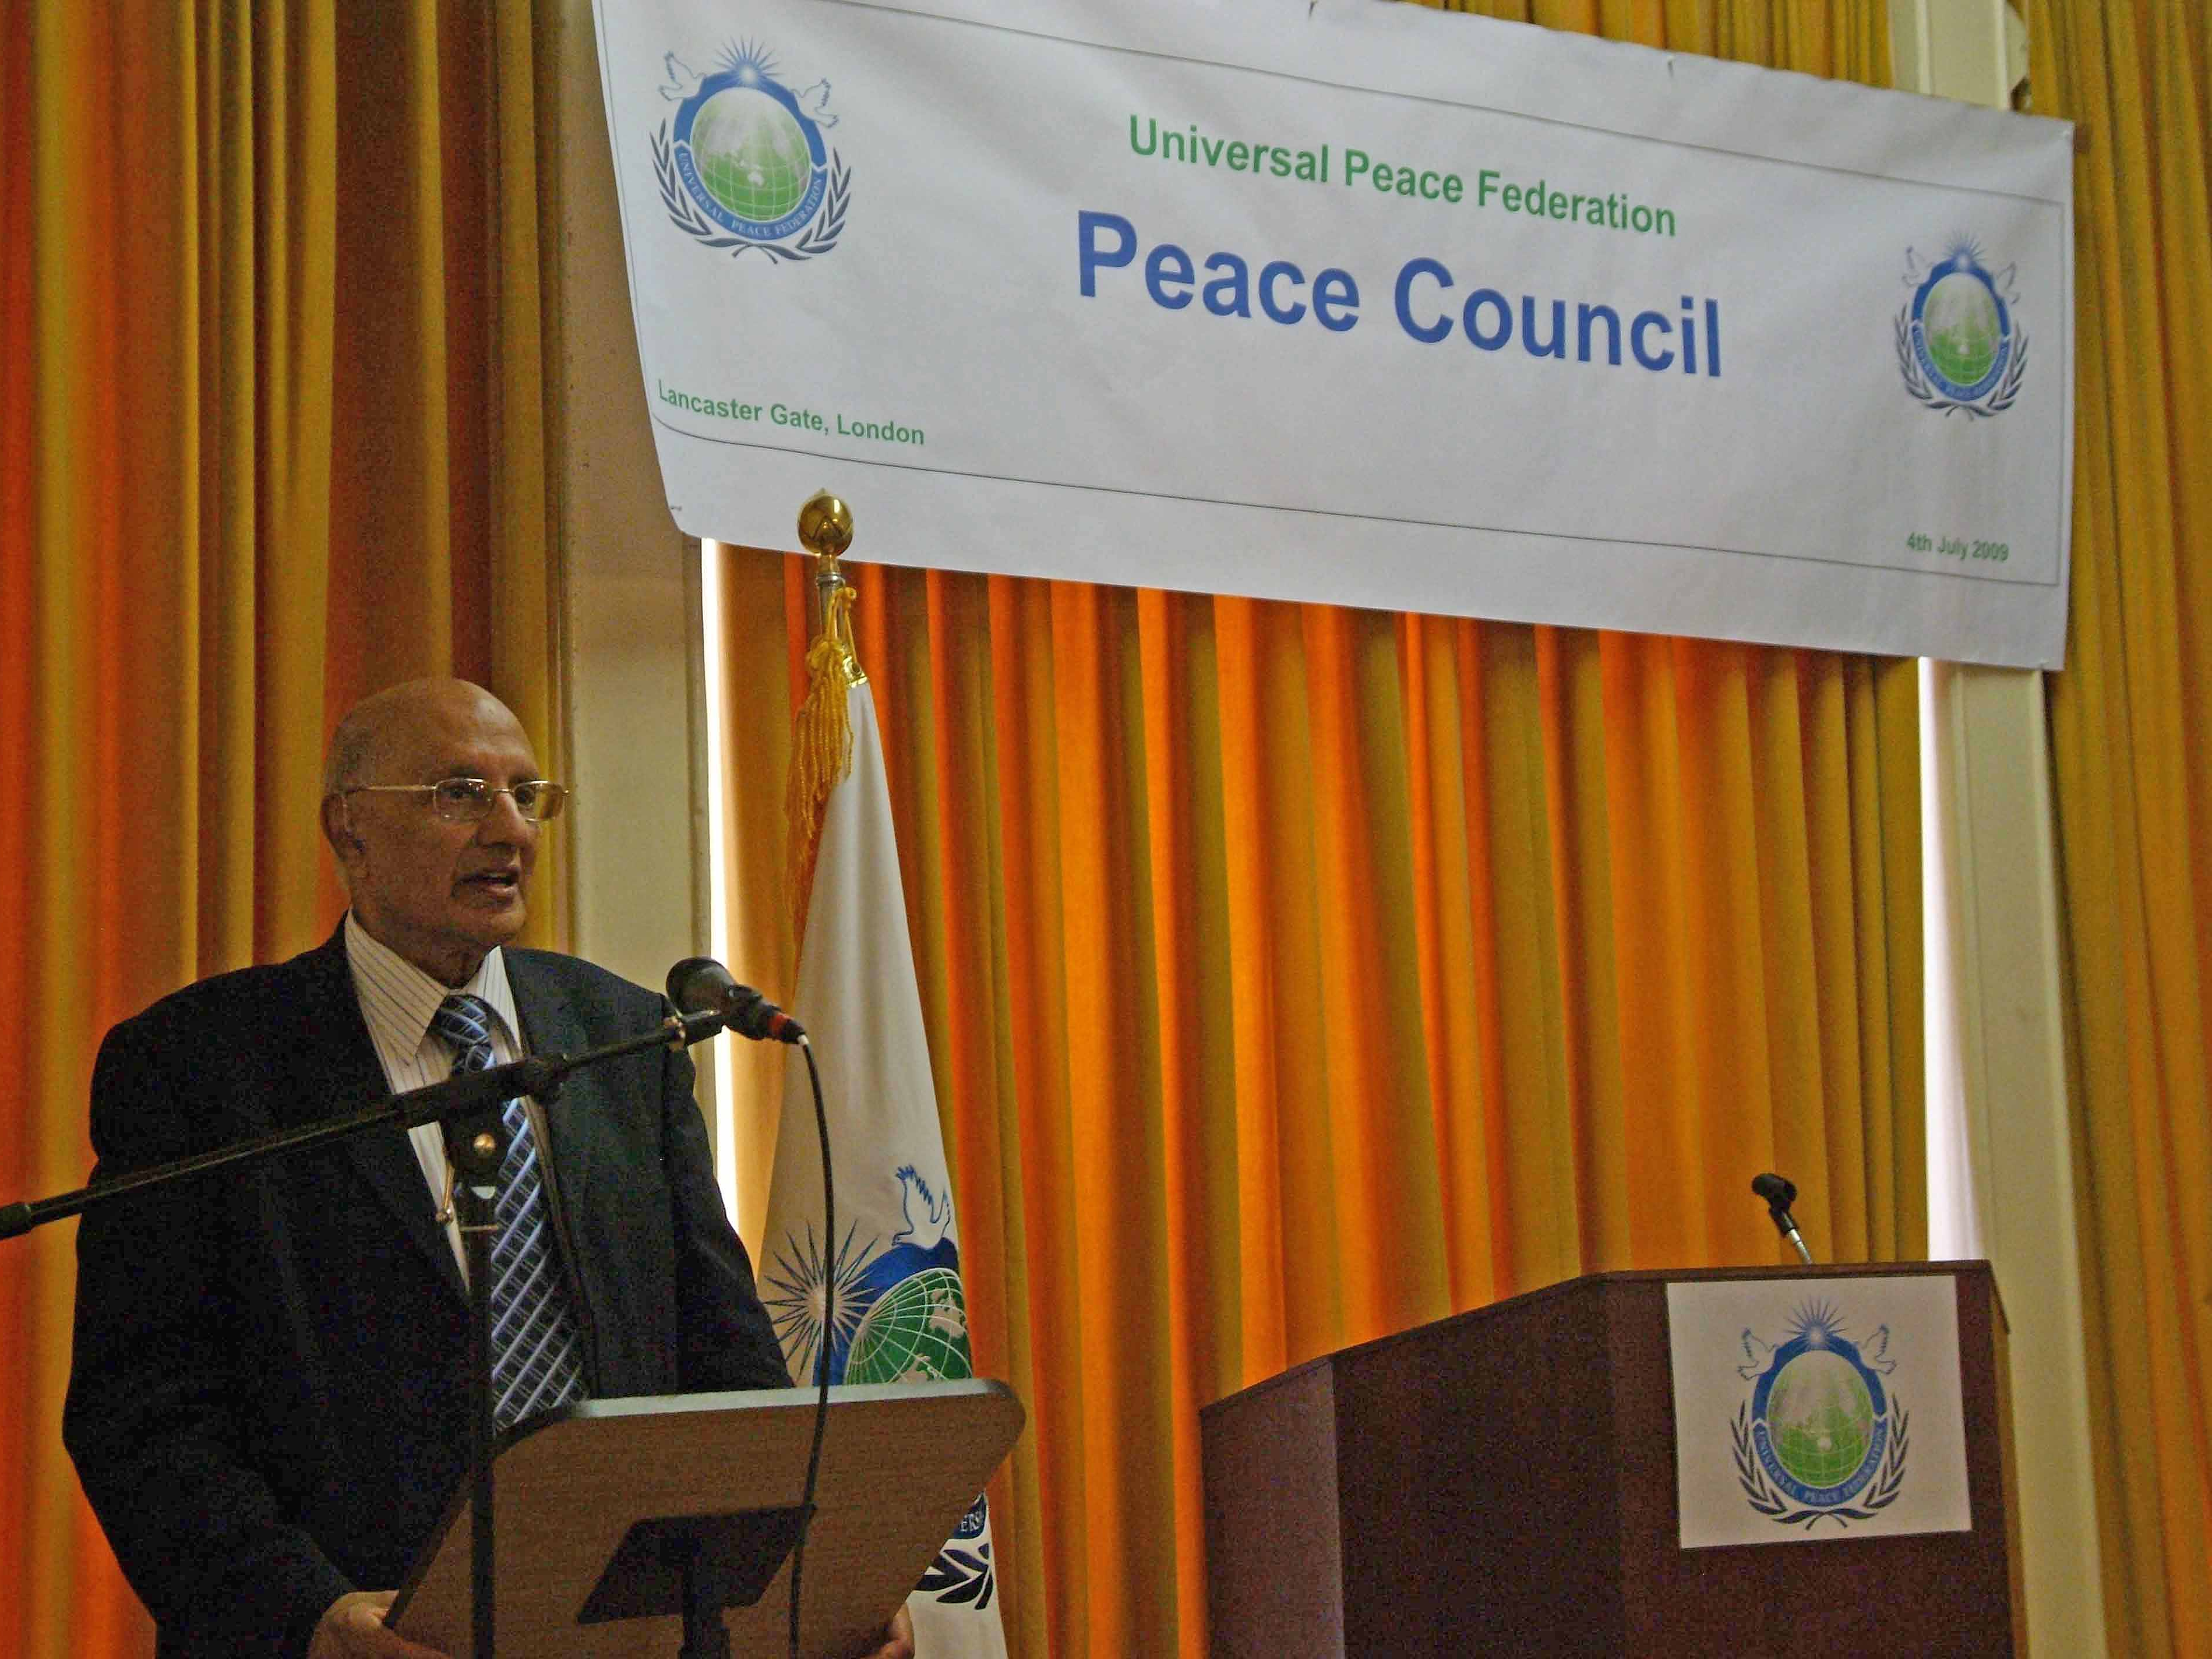
UPF UK Peace Council - July 4th 2009
Lord King UPF Patron
Notes:
Lord King of West Bromwich has been a strong supporter of UPF. He opened the Peace Council and stayed throughout the day.
The Peace Council allowed us to bring together all the Committees and the Branches of UPF.

Slide 21
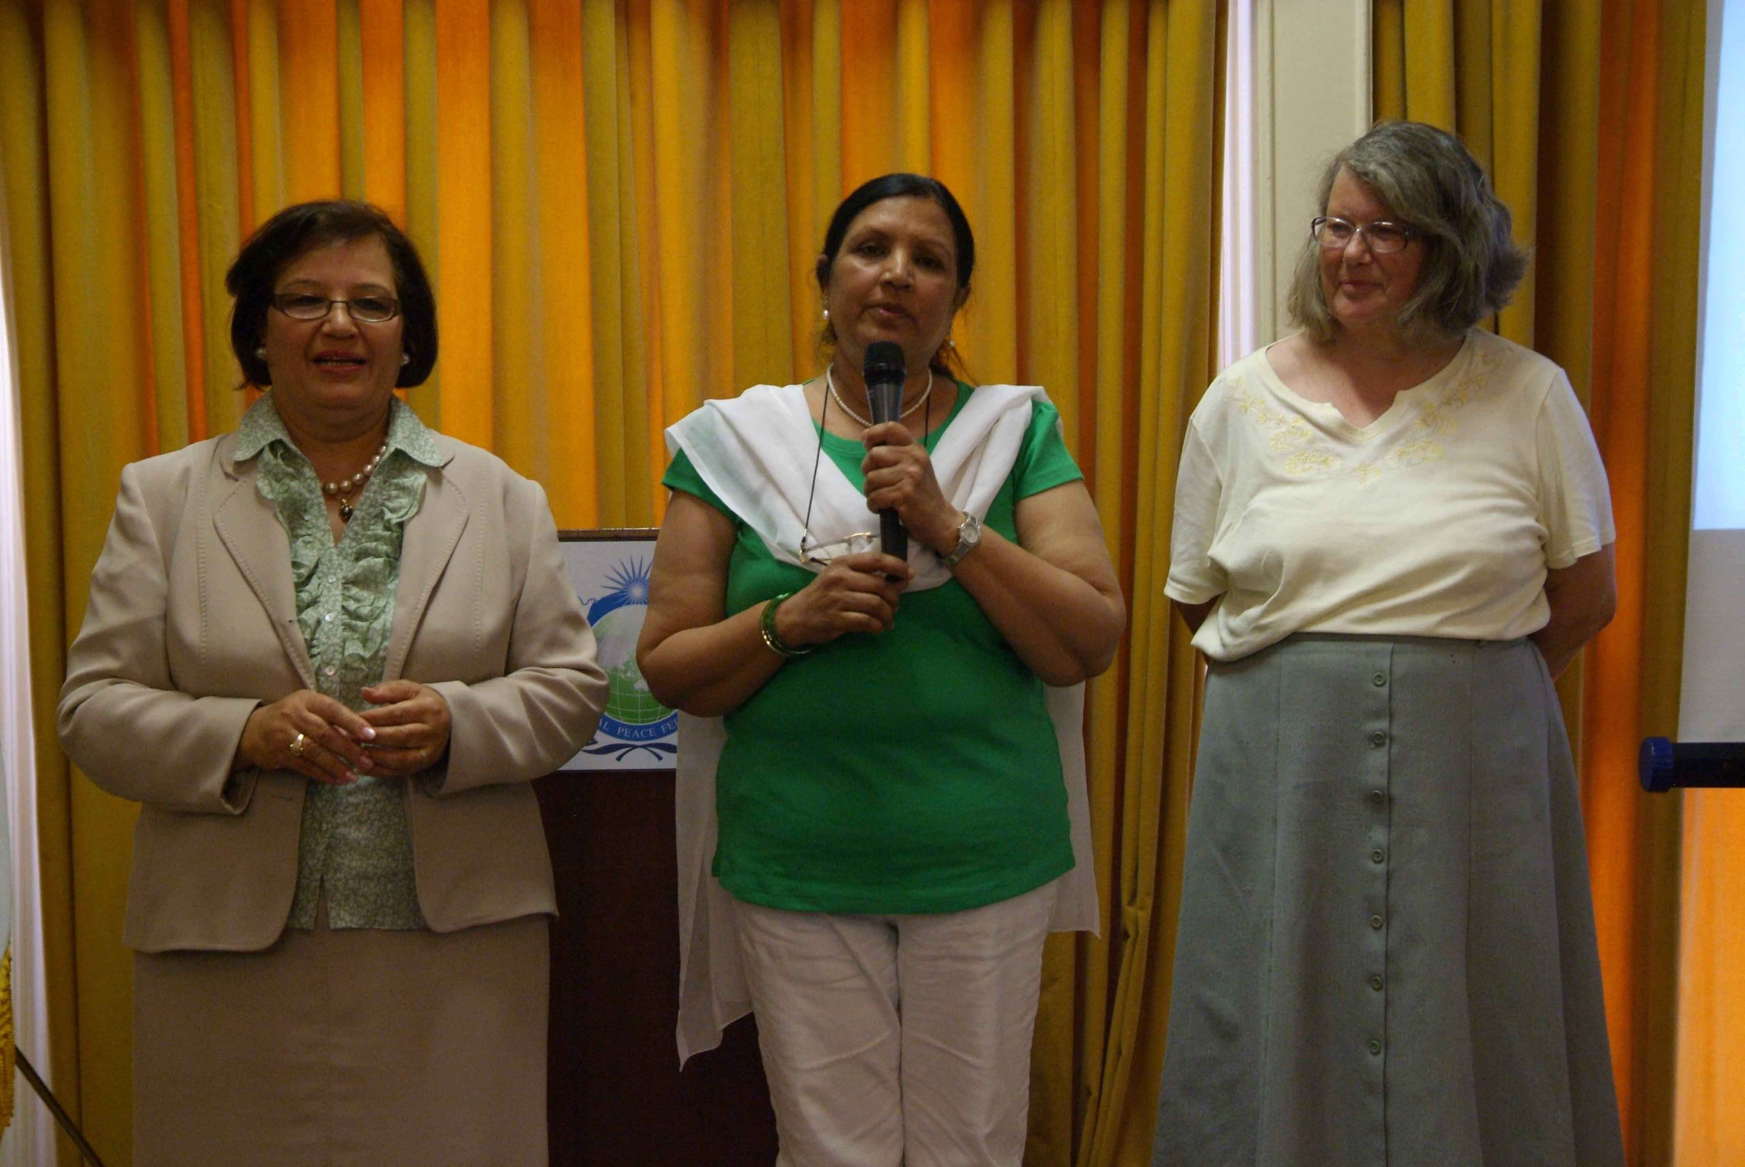
UPF UK Peace Council July 4th 2009
Community Cohesion Committee
Notes:
Saleha Jaffer, Janet Baddeley and Margaret Ali have been largely responsible for UPF’s many Community Cohesion activities. They are planning to hold a large event for Forgiveness and Reconciliation on October 4th. Tom Brake MP, Lord Parekh, Yasmin Alibhai Brown and Keith Best, the Chief Executive of the Immigration Advisory Service will be speaking on the Benefits of Immigration to the UK on November 24th.

Slide 22
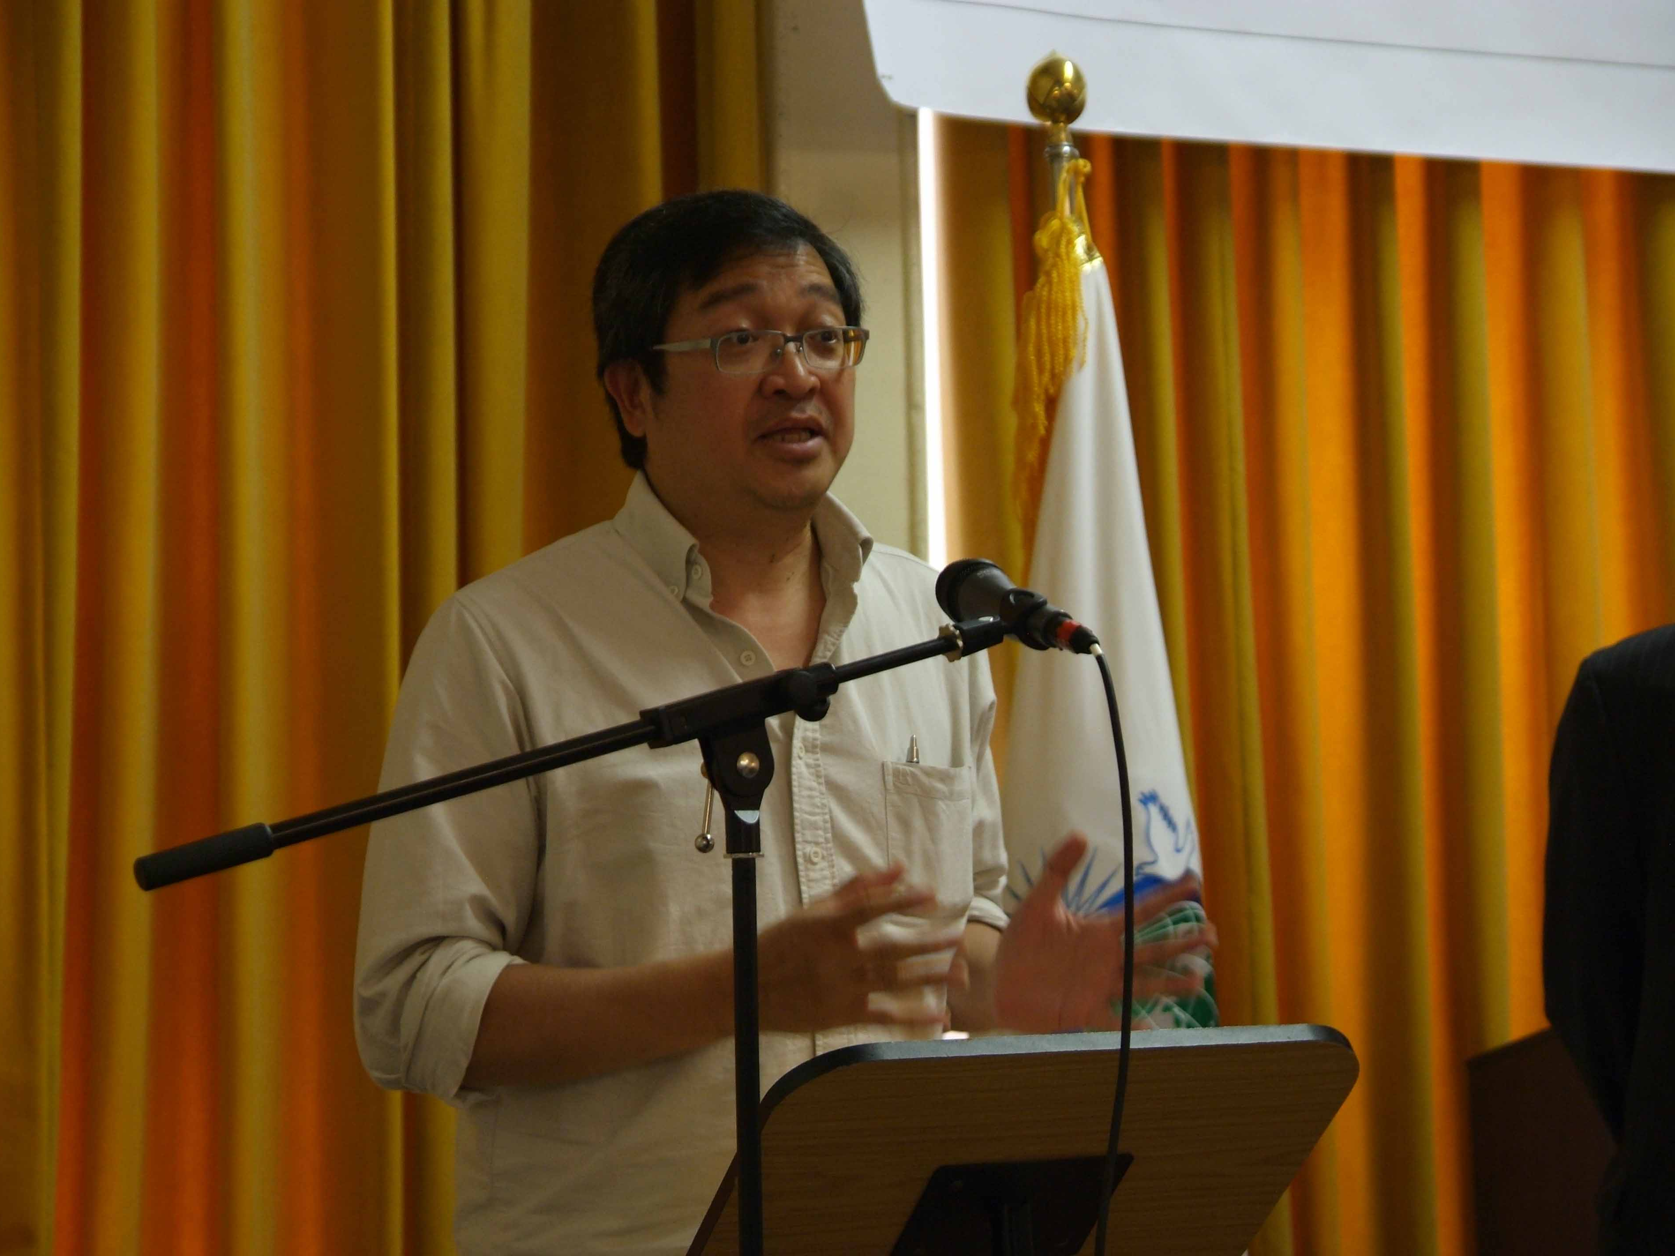
UPF UK Peace Council July 4th 2009
Mindanao Peace Initiative -UK
Notes:
Gene Alcantara, who is a Philippine journalist settled in the UK, announced to the Peace Council and then to his community in the UK that they should support the Mindanao Peace Initiative. This has been widely supported within the community. He wrote to them saying:
‘You will know that the conflict in Mindanao continues to cause pain and suffering, dislocation and costs in terms of the economy, loss of human life, increased poverty and destruction of localities. As we have also seen recently the situation allows kidnap-for-ransom activities which create fear and deflect tourism and investment in the region.
I am writing to tell you that a Mindanao Peace Initiative was launched during the Global Peace Festival Mindanao in September 2008. The event was co-sponsored by the Universal Peace Federation (UPF), the Philippine Government at national and local levels, and non governmental organisations. Enclosed herewith please find the Declaration of the Inauguration of the Mindanao Peace Initiative (MinPI).
In our desire to get involved in the pursuit of peace in Mindanao and help our compatriots there, we have set up a UK Committee to support and seek funding for the MinPI. I hope you will be able to join us and contribute to the peace efforts.
A couple of projects we will be supporting this year are the Lanao Del Norte (LDN) Peace School Model, and the First Mindanao Hiphop Convention to be held in August 2009.
With Service For Peace we are also exploring the possibility of advocating volunteerism and service in LDN and Davao City, as well as implementing micro financing and soft loans for young entrepreneurs and women.
The MinPI UK Committee will be overseen by UPF and its partners, particularly in the Filipino community. Administration and handling of contributions/sponsorships will be provided by International Relief Friendship Foundation, Inc. (IRFF), a UK charity organization [http://www.irff.org/]. Execution on the ground in Mindanao will be the responsibility of Service For Peace [www.serviceforpeace.org] and partner Filipino NGOs.
I would be grateful if you could please forward this to friends and kababayans who might be interested in getting involved or to contribute financial and other help. If anybody wishes to provide any financial help, please go directly to http://www.irff.org/ to do so, specifying your contribution is for the Mindanao Peace Initiative UK.’

Slide 23
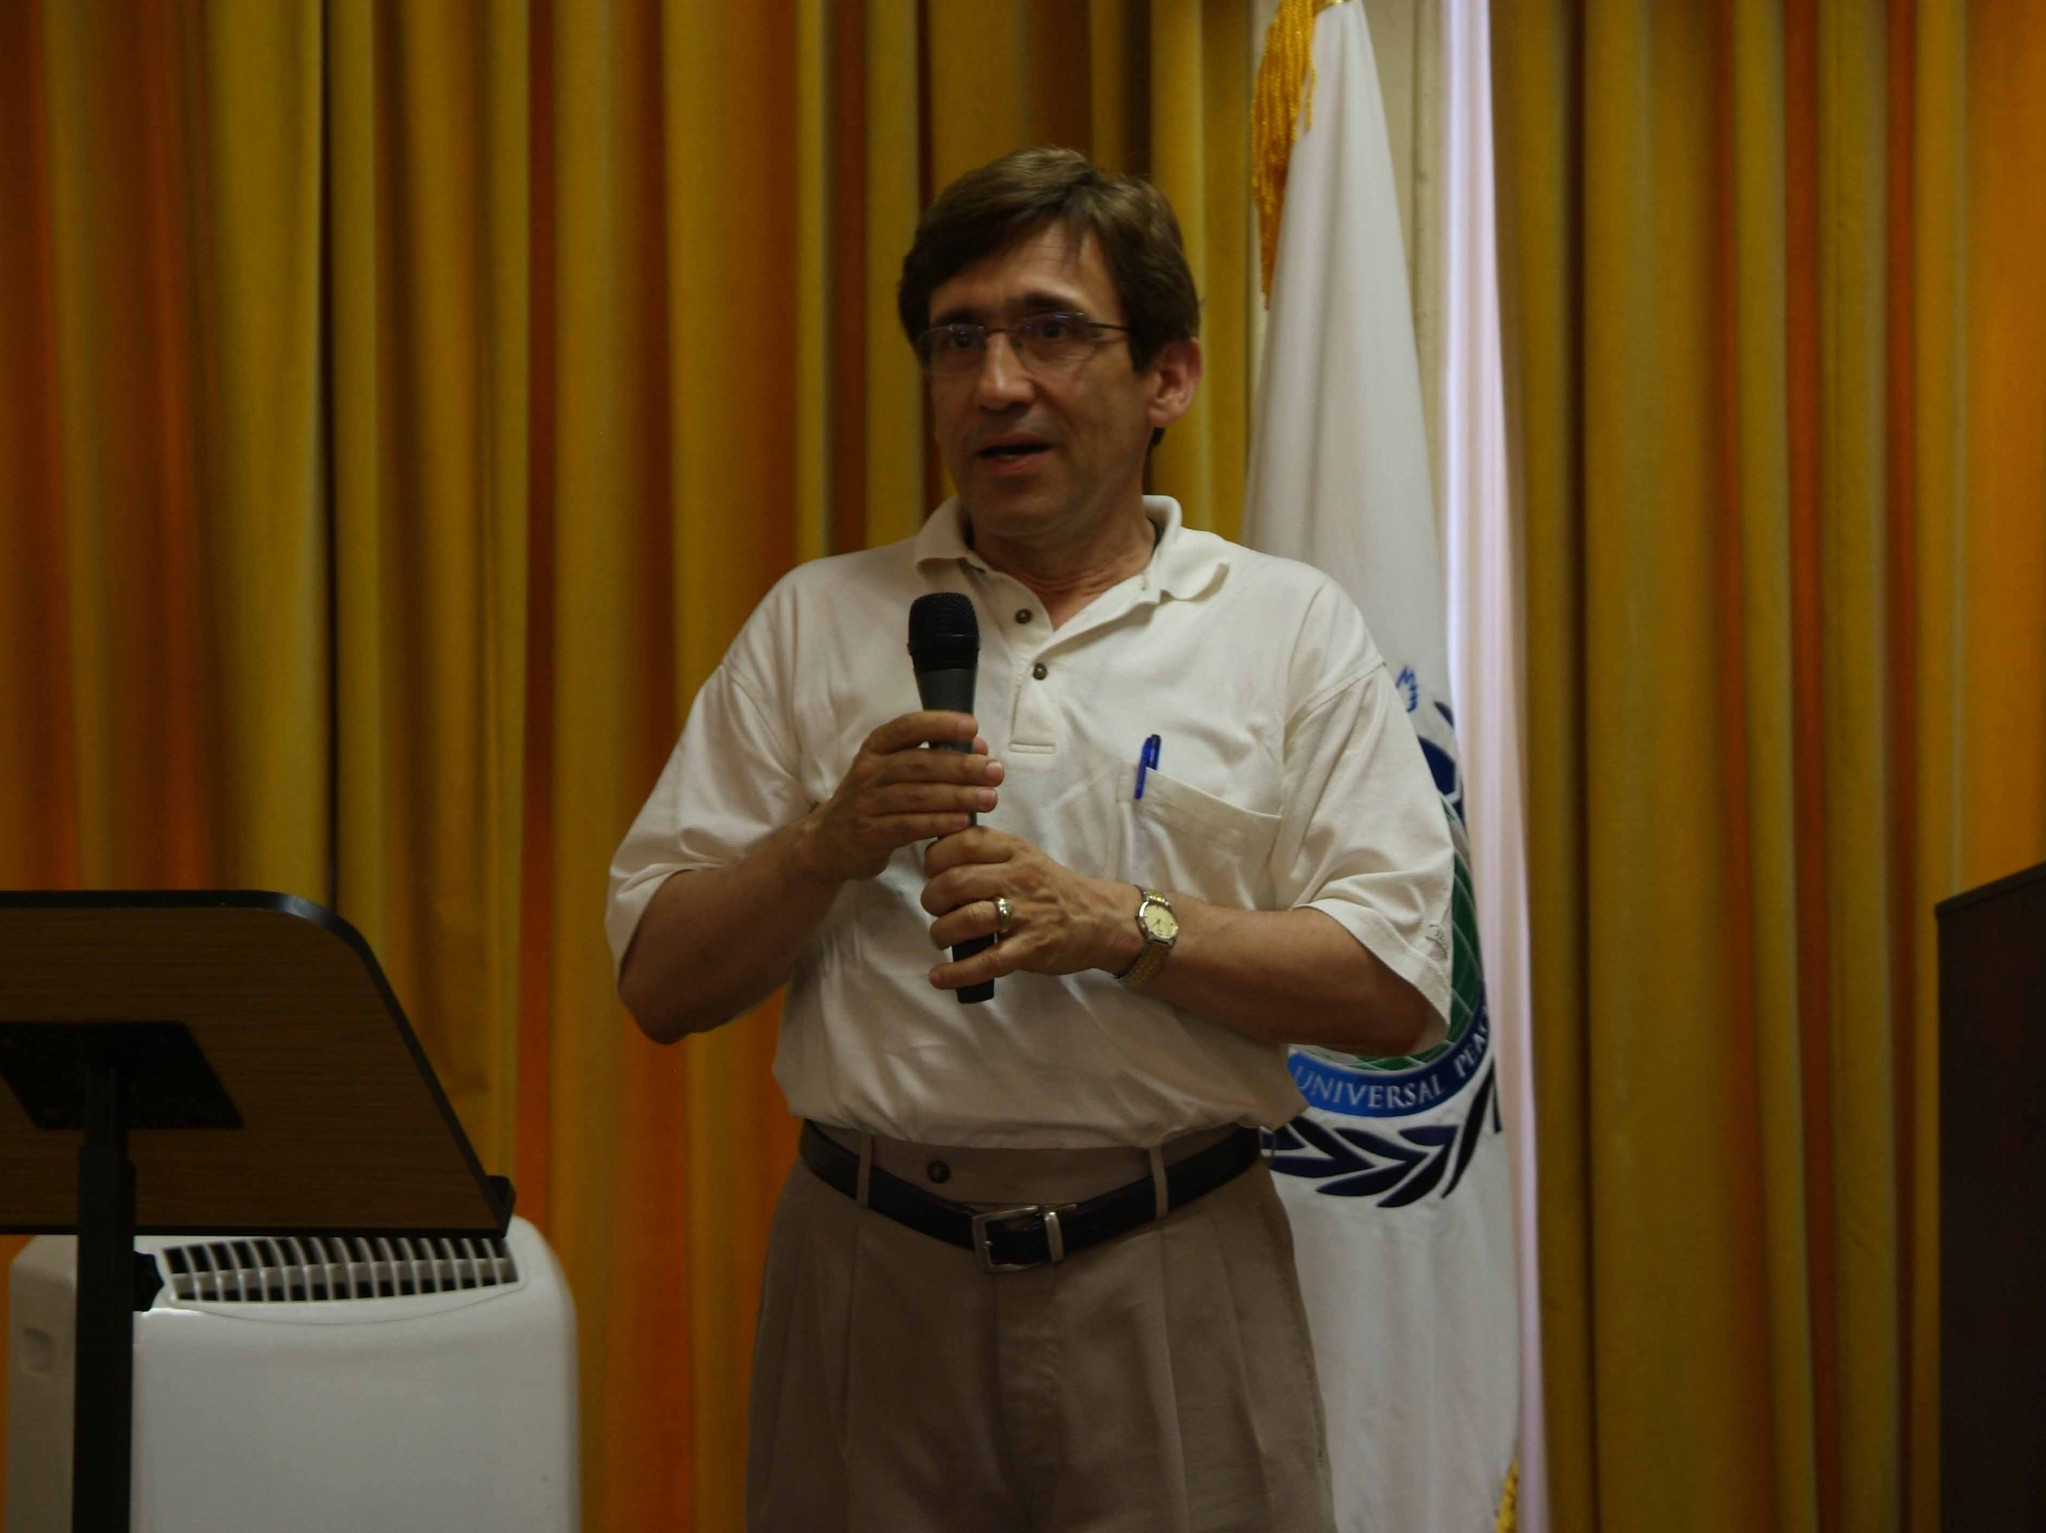
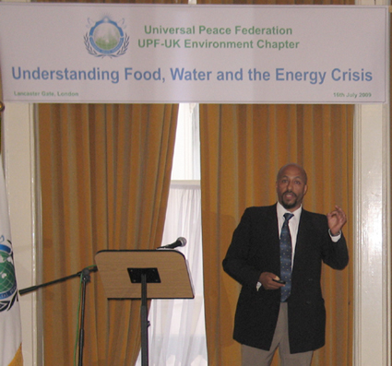
UPF UK Peace Council
Environment Chapter - July 4th 2009
Notes:
Dr Marios Gerogiakas has been promoting an Environment Awareness Chapter in the UK. There have been several meetings in 2008 and in 2009. It is easy to explain the need for a change of values and lifestyles through these occasions. Several famous people will speak in future meetings in the Autumn. Insert is a recent events with Dr Yacob Mulugetta of Surrey University.

Slide 24
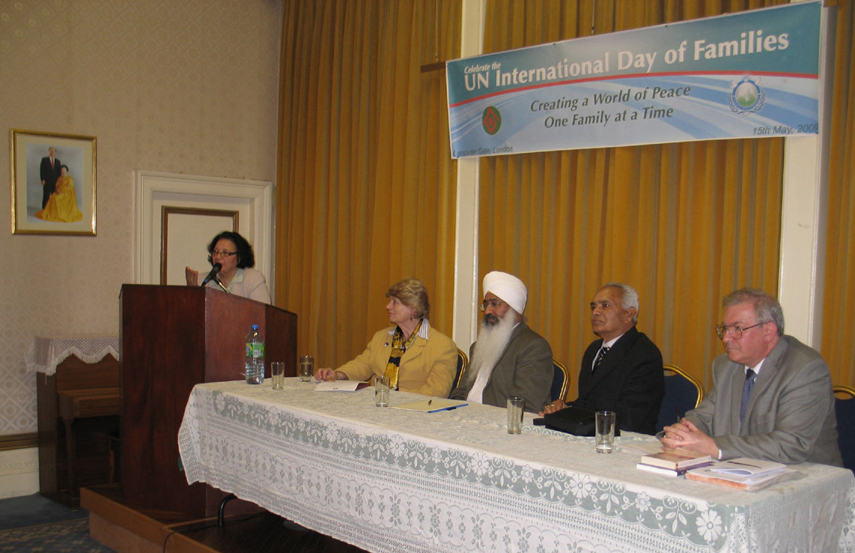
UN International Day of Families May 15th 2009 Marriage and Family Committee
Notes:
The Marriage and Family committee has had a number of events during the last two years. This was a recent event on the UN International Day of Families another was held jointly with the Women’s Federation for World Peace.

Slide 25
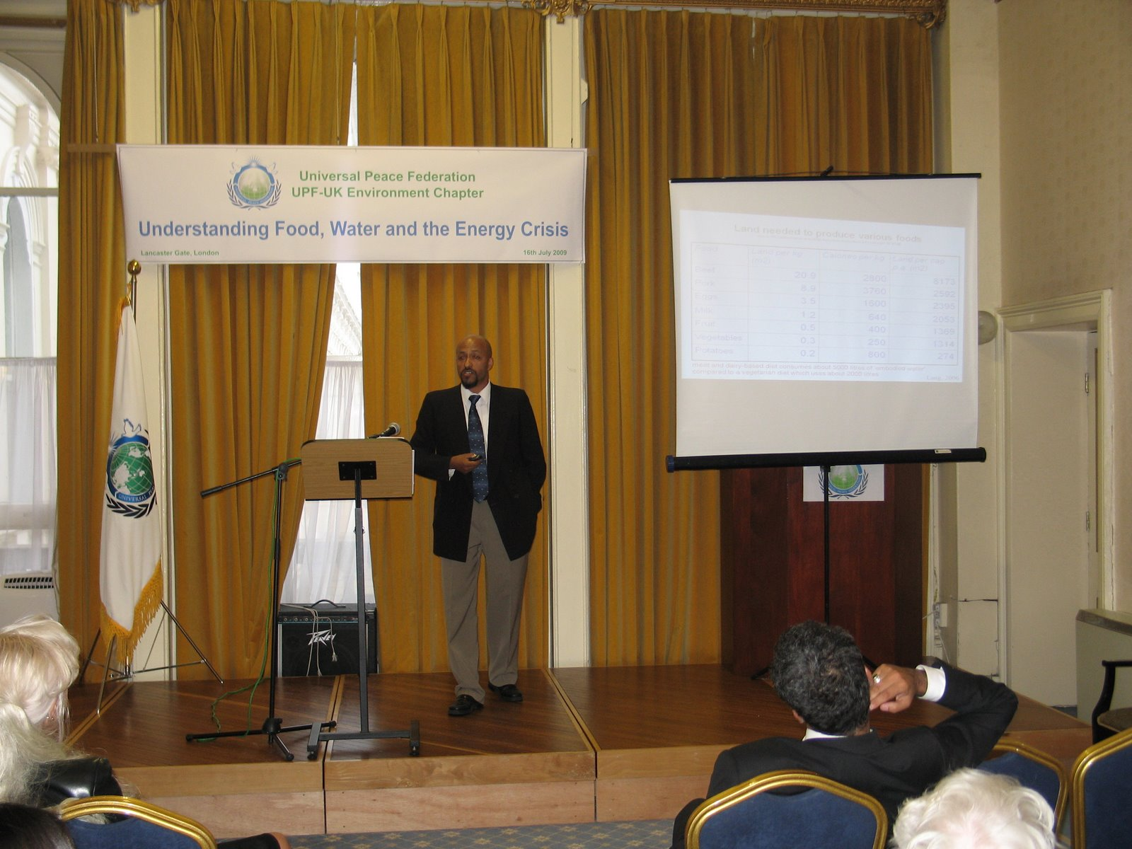
Food Water and Energy Crisis
Dr Yacob Mulugetta

Slide 26
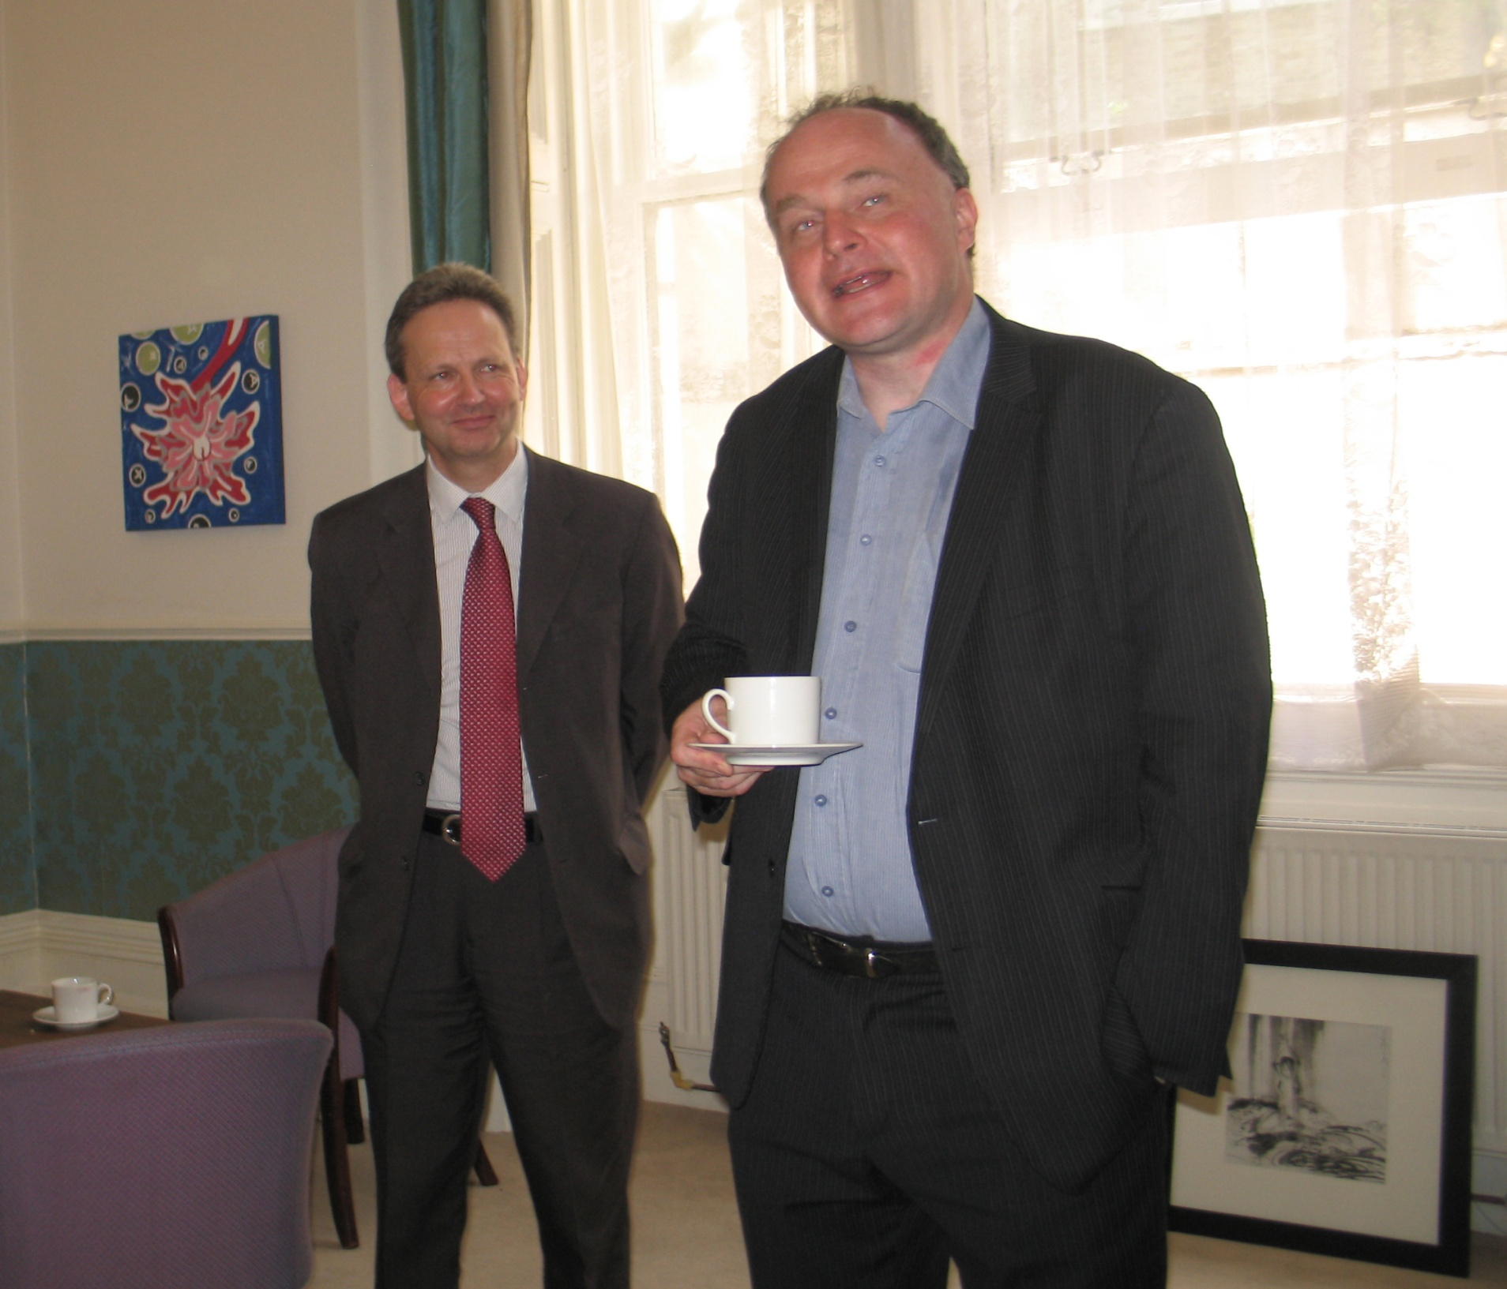
John Grogan MP
August 22nd Cultural Programme
John Grogan MP
August 22nd 2009
Cultural Programme – An Oriental Experience
Notes:
John Grogan MP
August 22nd 2009
Cultural Programme – An Oriental Experience

Slide 27
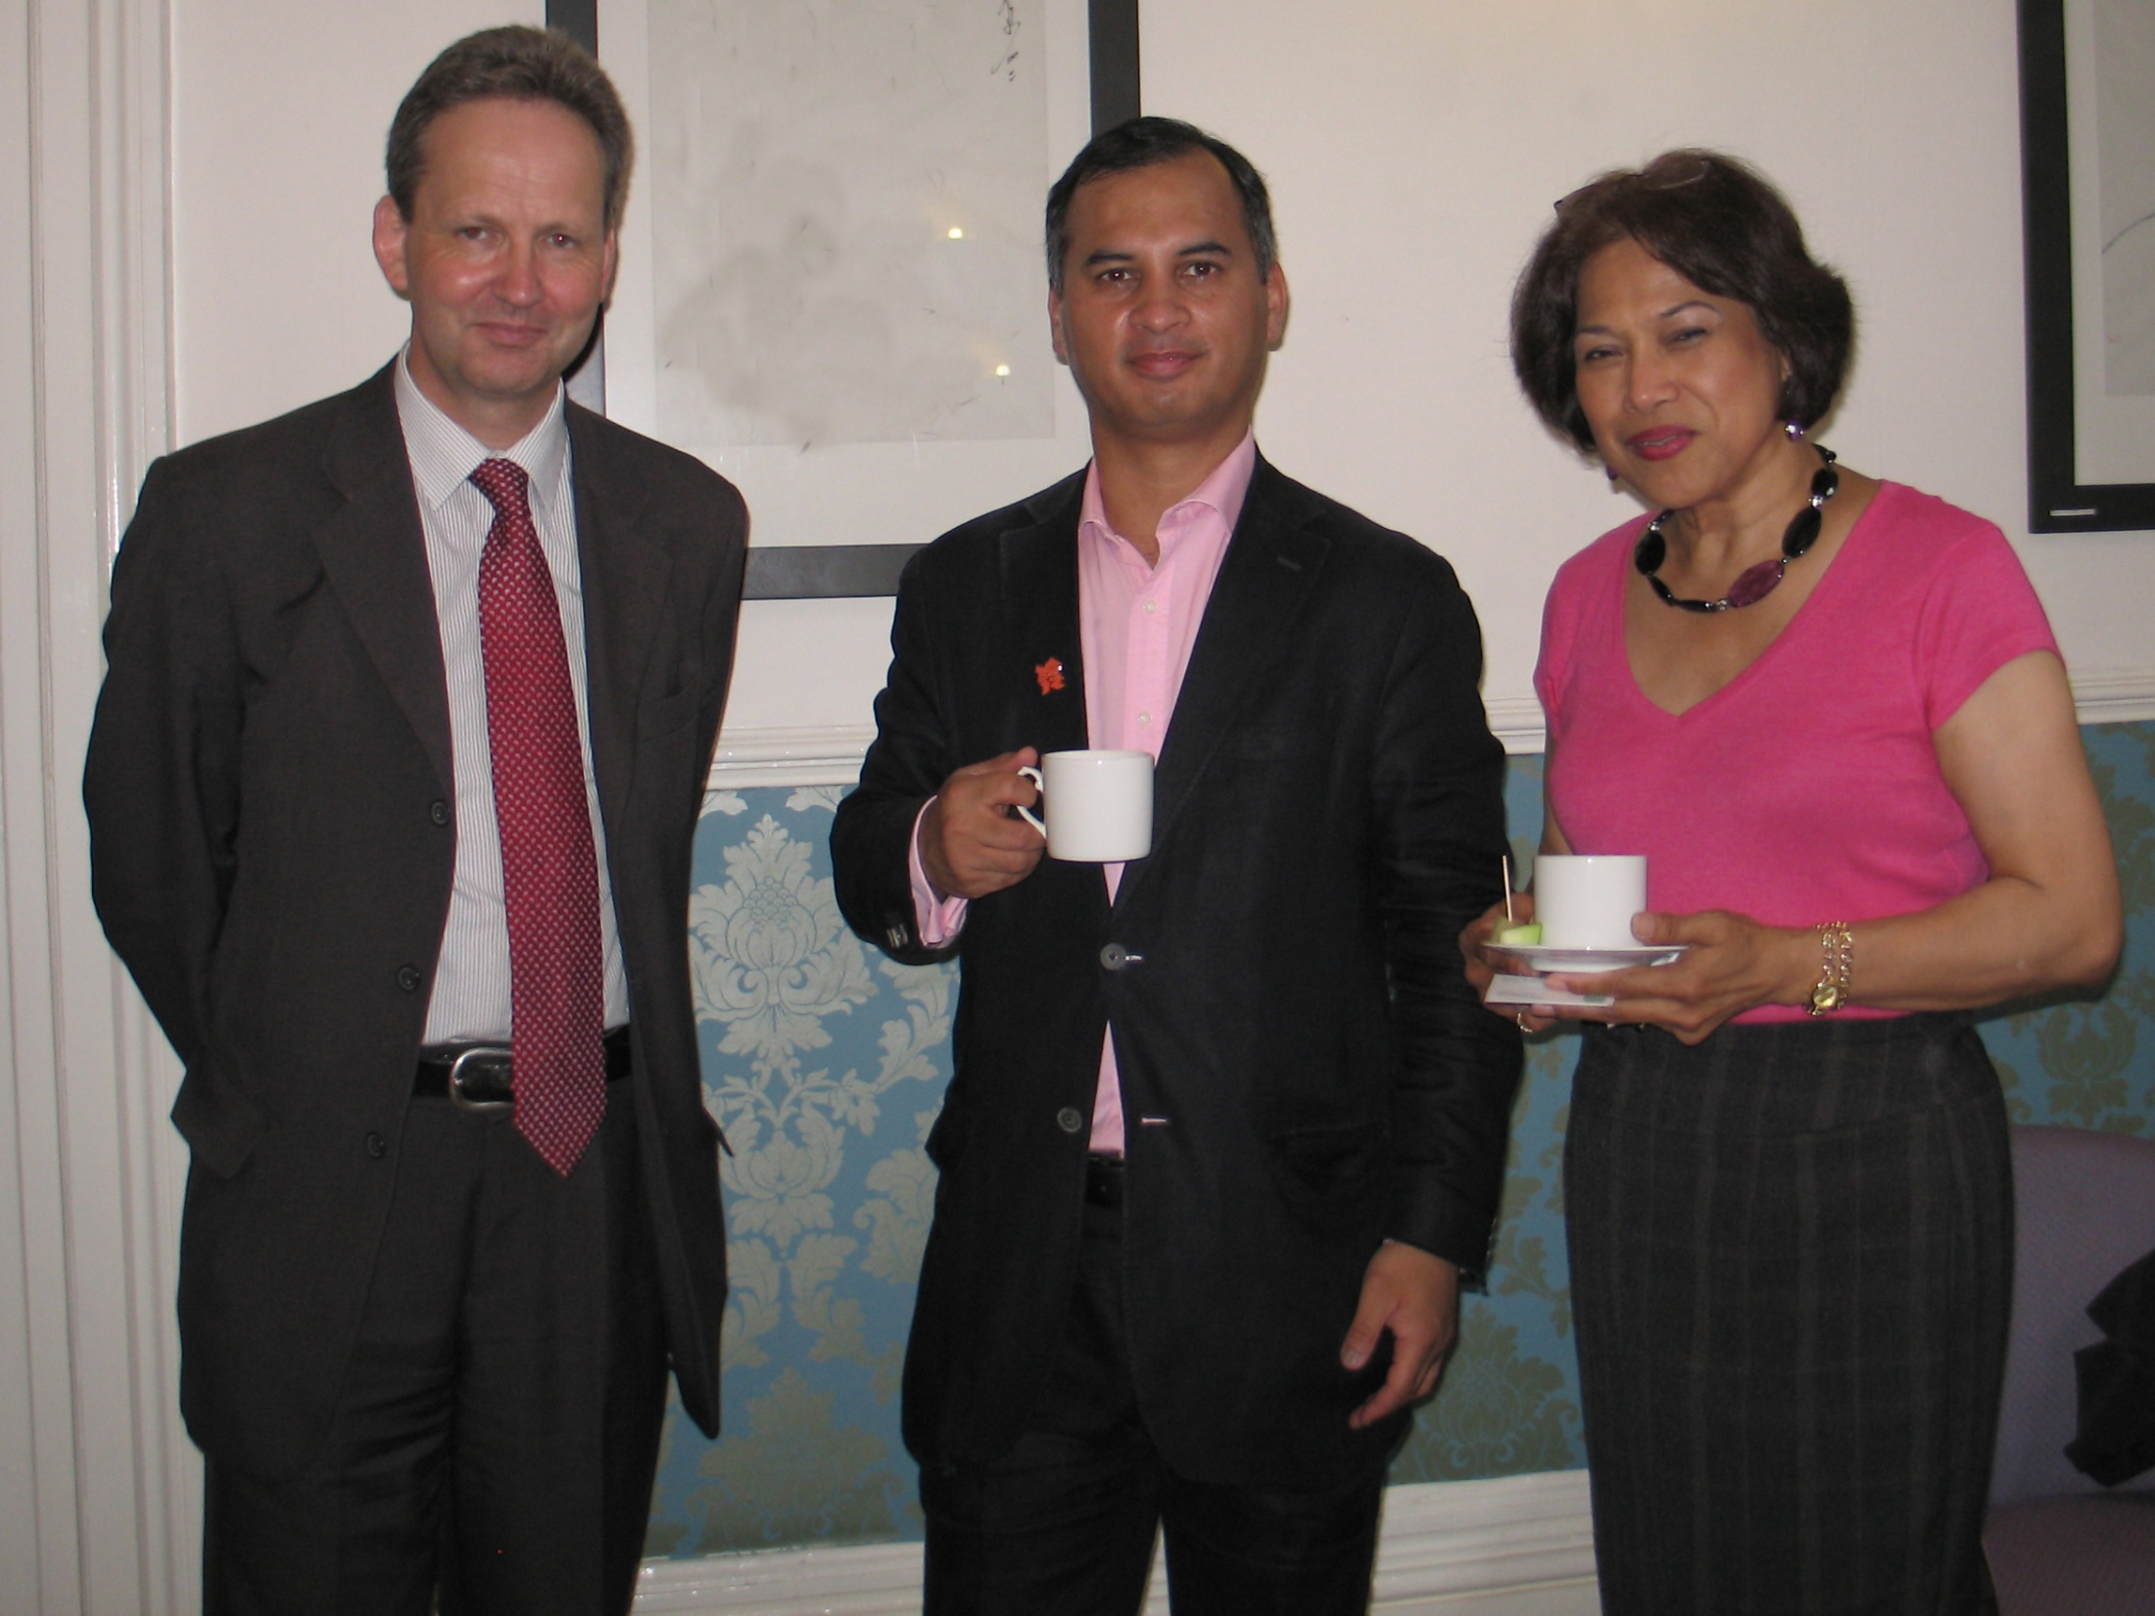
Murad Qureshi
London Assembly Member
August 22nd 2009
Cultural Programme – An Oriental Experience

Slide 28
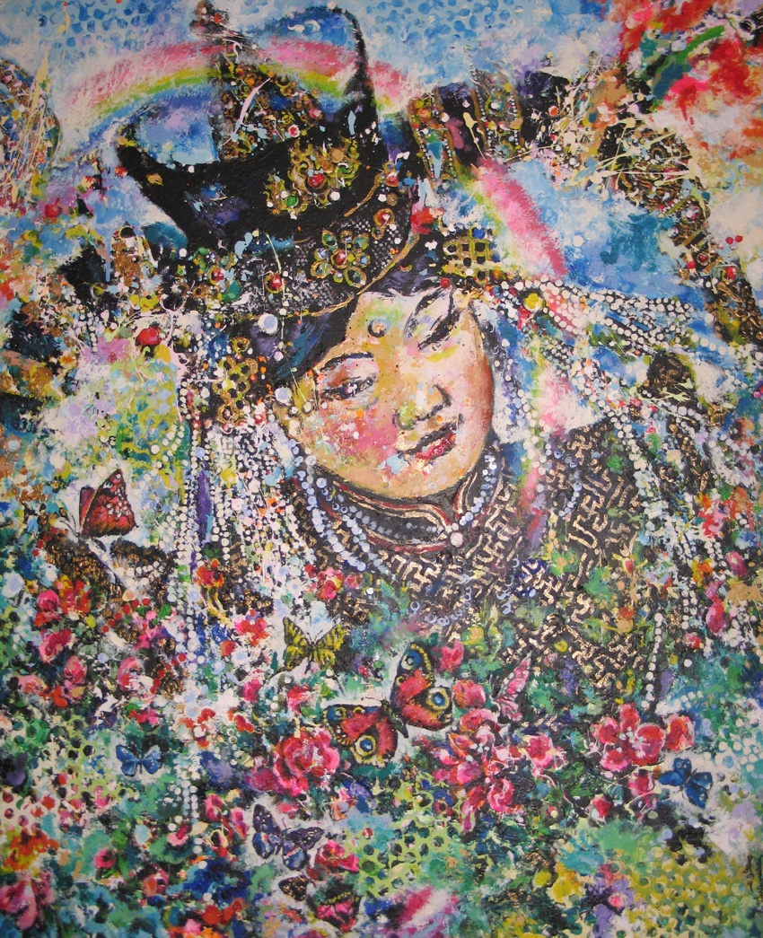
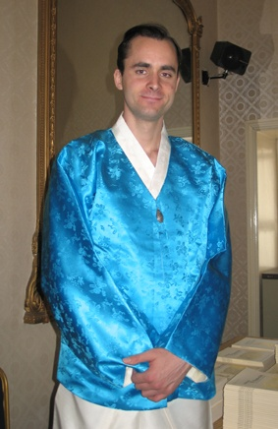
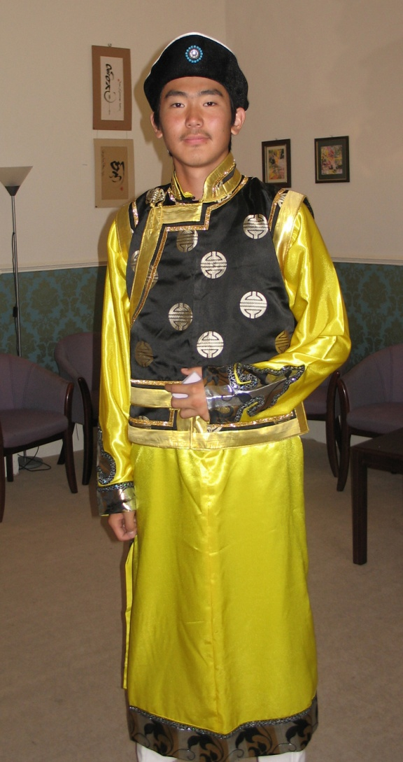
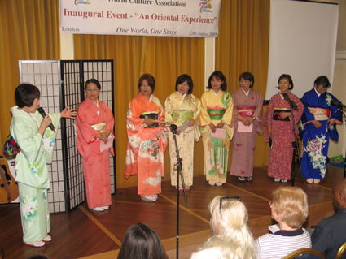
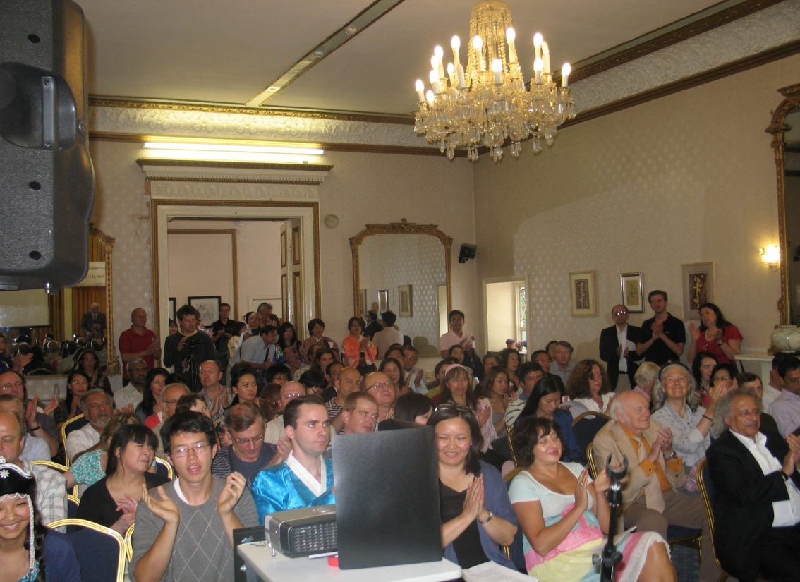
Notes:
An Oriental Experience – World Cultural Association - August 22nd Peter Graham

Slide 29
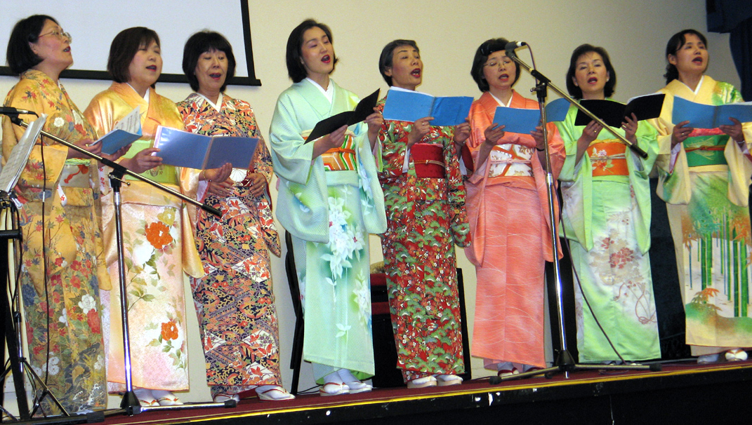
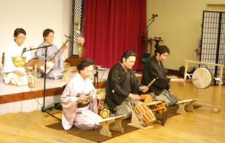
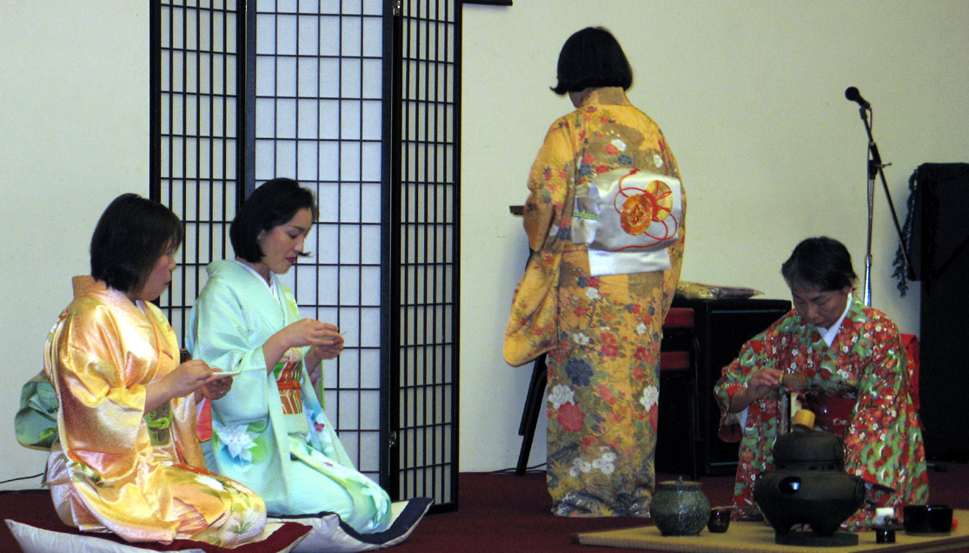
Sakura Club
Artists for Peace
Notes:
Sakura Club have performed in many venues to promote UPF. They have joined together with others to form a cultural group called Artists for Peace.

Slide 30
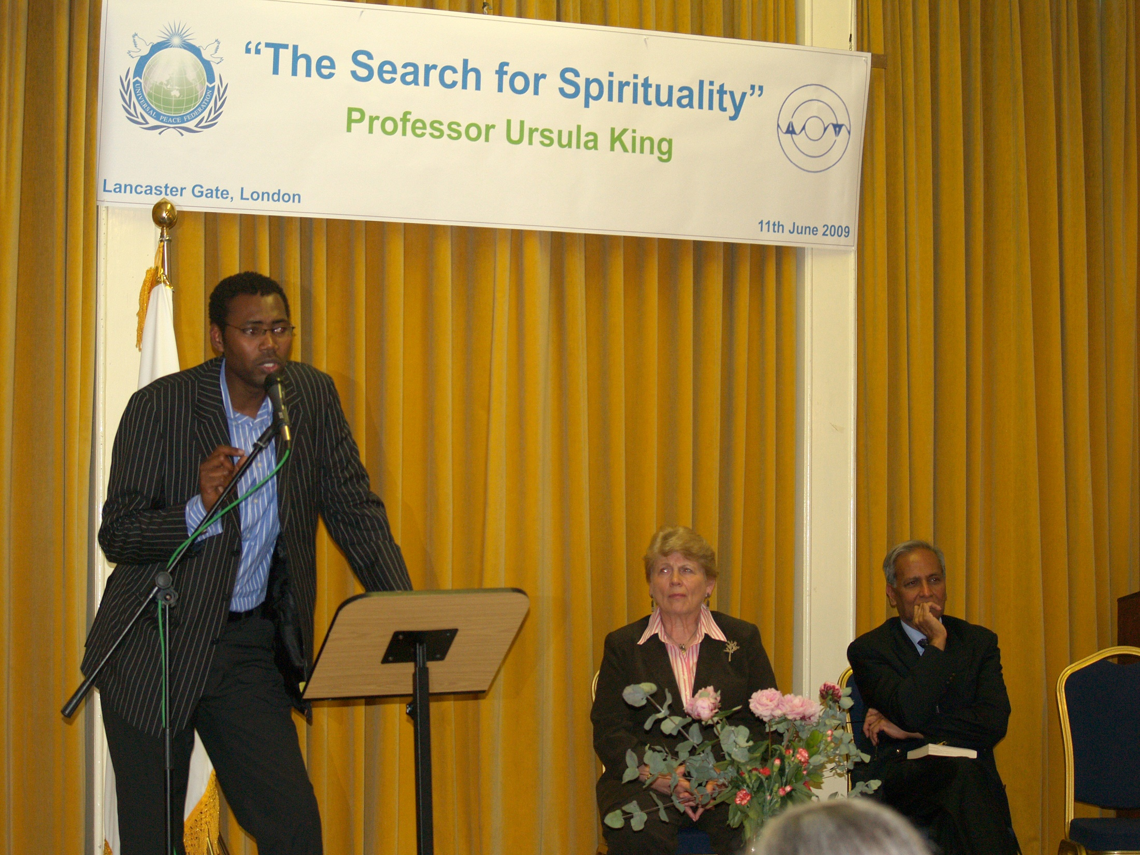
UPF UK Prof. Ursula King Book Launch
‘In Search of Spirituality’ June 11th 2009
Notes:
The Interfaith Committee and the British Academy for World Peace, (UK’s Professors for World Peace Academy) held a joint event on the 11th of June to launch a book of Professor Ursula King. Professor King introduced True Mother so warmly in 1993 during the speaking tour visit to the UK. She has been a friend of the Movement since the early 1980’s. A young Imam Mahmadou Bocoum is responding to her book in this photograph. Jay Lakhani, the Hindu Council – UK Education Director, responding to Professor Ursula King’s book.

Slide 31
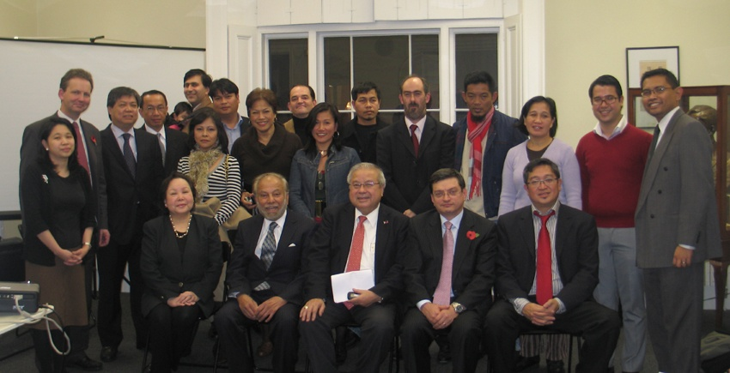
Mindanao Peace Initiative – UK
Philippines Embassy, Oct. 24th, 2009

Slide 32
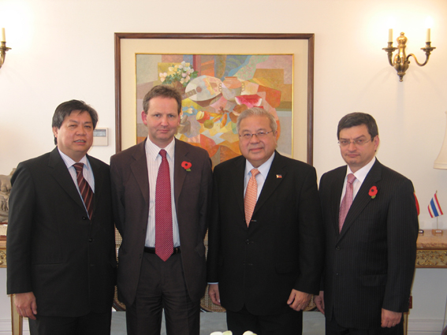
Mindanao Peace Initiative – UK
Philippines Embassy October 24th 2009

Slide 33
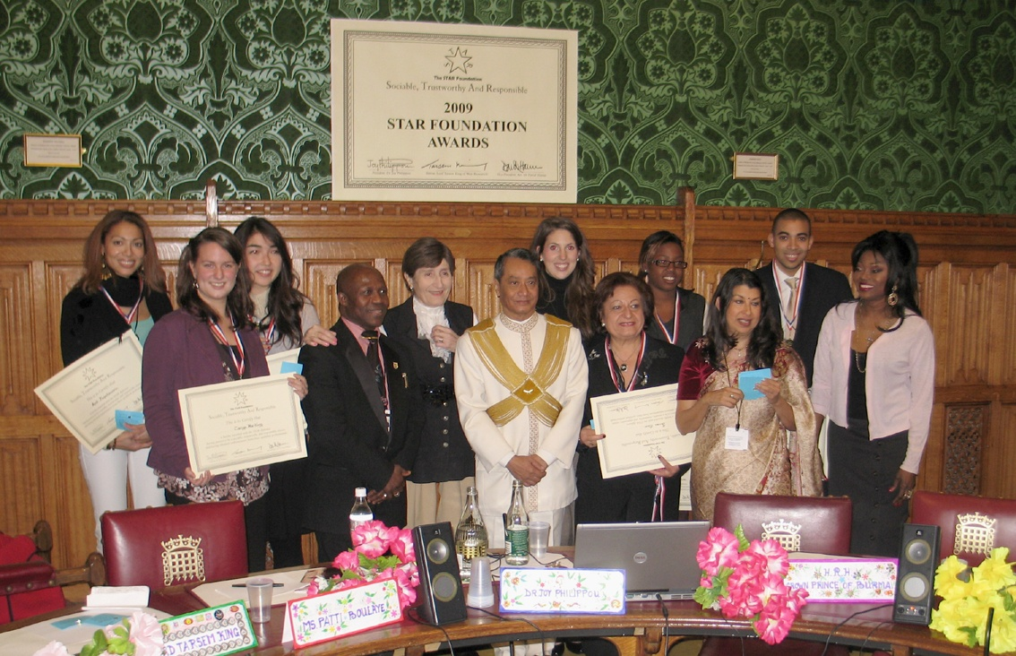
Supported Star Foundation Youth Awards
Nov. 9th 2009

Slide 34
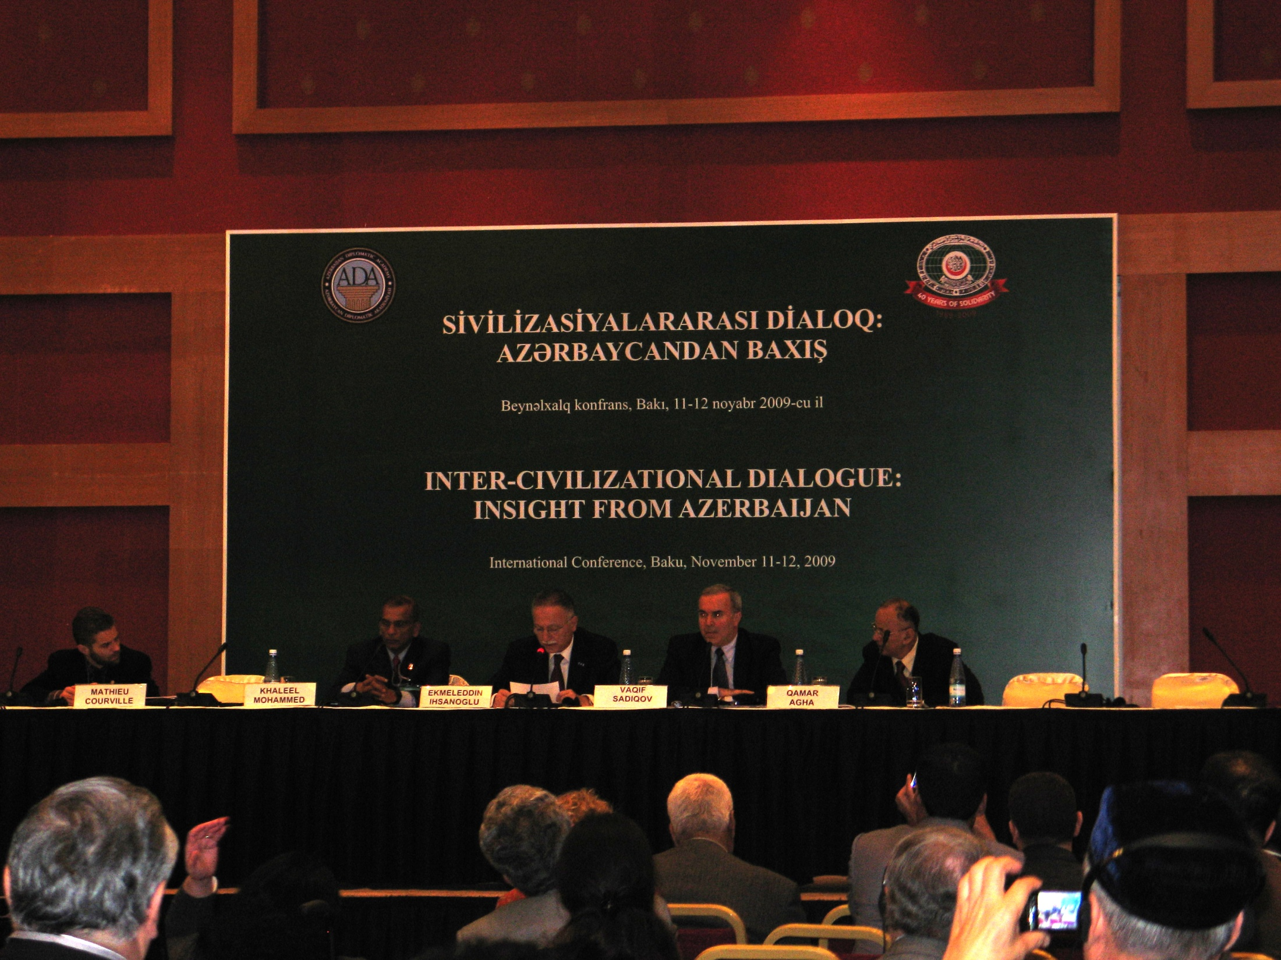
‘Inter-Civilizational Dialogue’
Baku, Azerbaijan
Organisation of Islamic Conference & Azerbaijan Diplomatic Academy

Slide 35
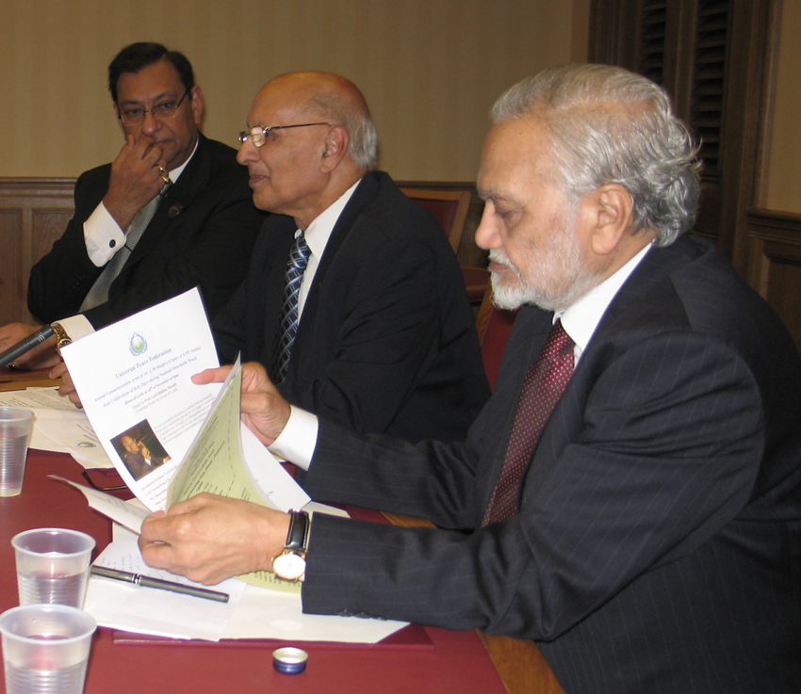
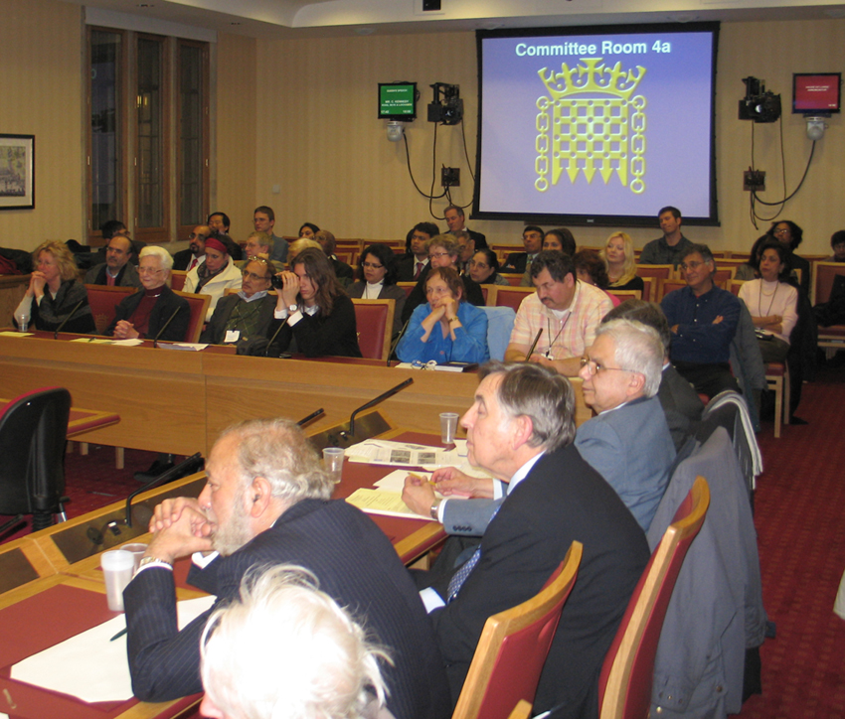
Dr. L M Singhvi Commemoration Celebration of Holy Events National Interfaith Week Nov. 18th

Slide 36
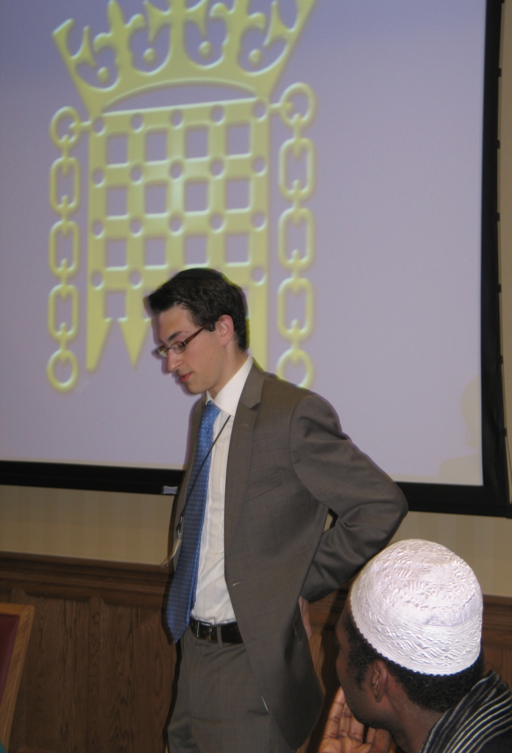
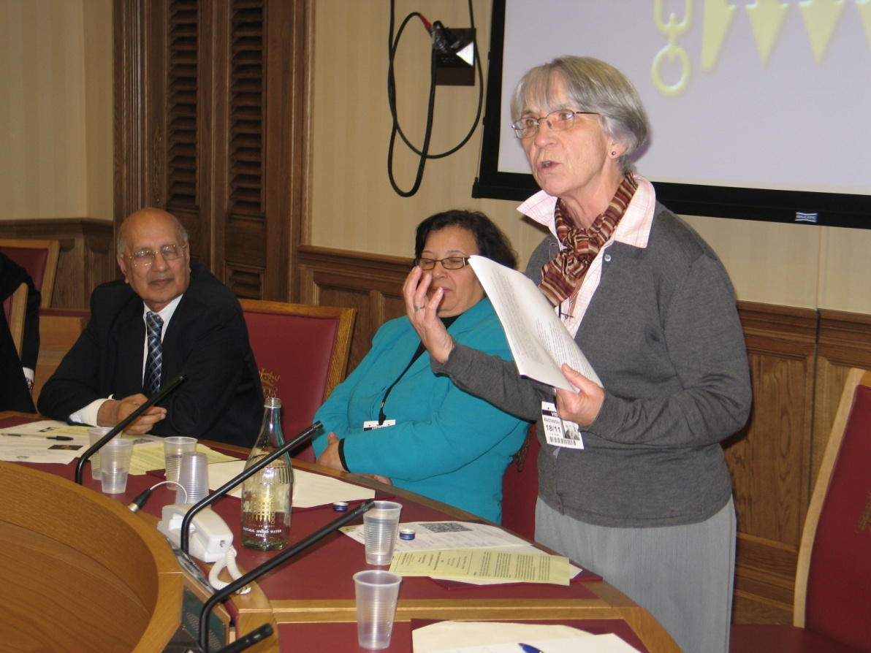
Dr. L M Singhvi Commemoration Celebration of Holy Events National Interfaith Week Nov. 18th

Slide 37
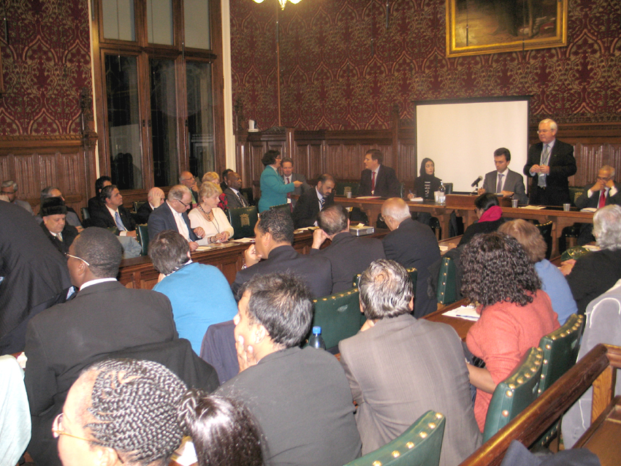
Immigrants Contribution to UK Nov. 24th

Slide 38
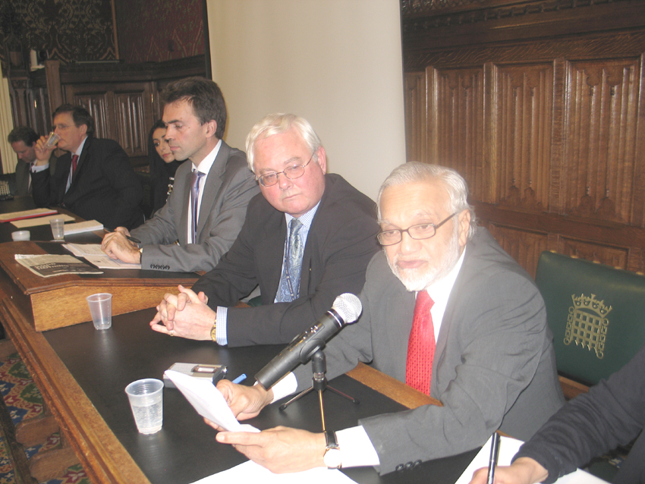
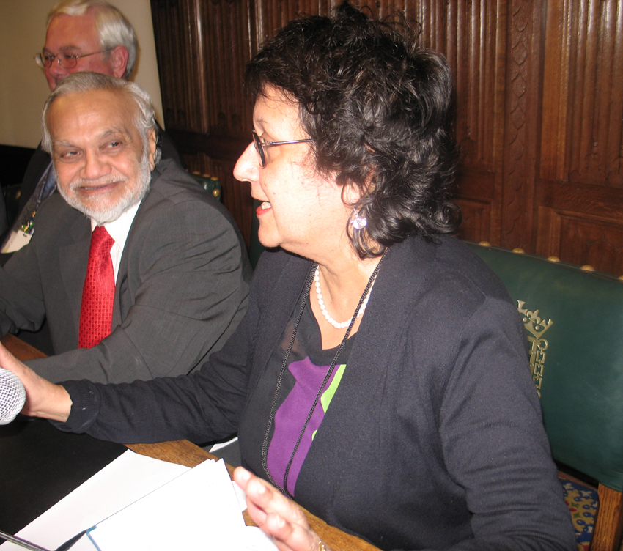
Immigrants Contribution to UK Nov. 24th

Slide 39
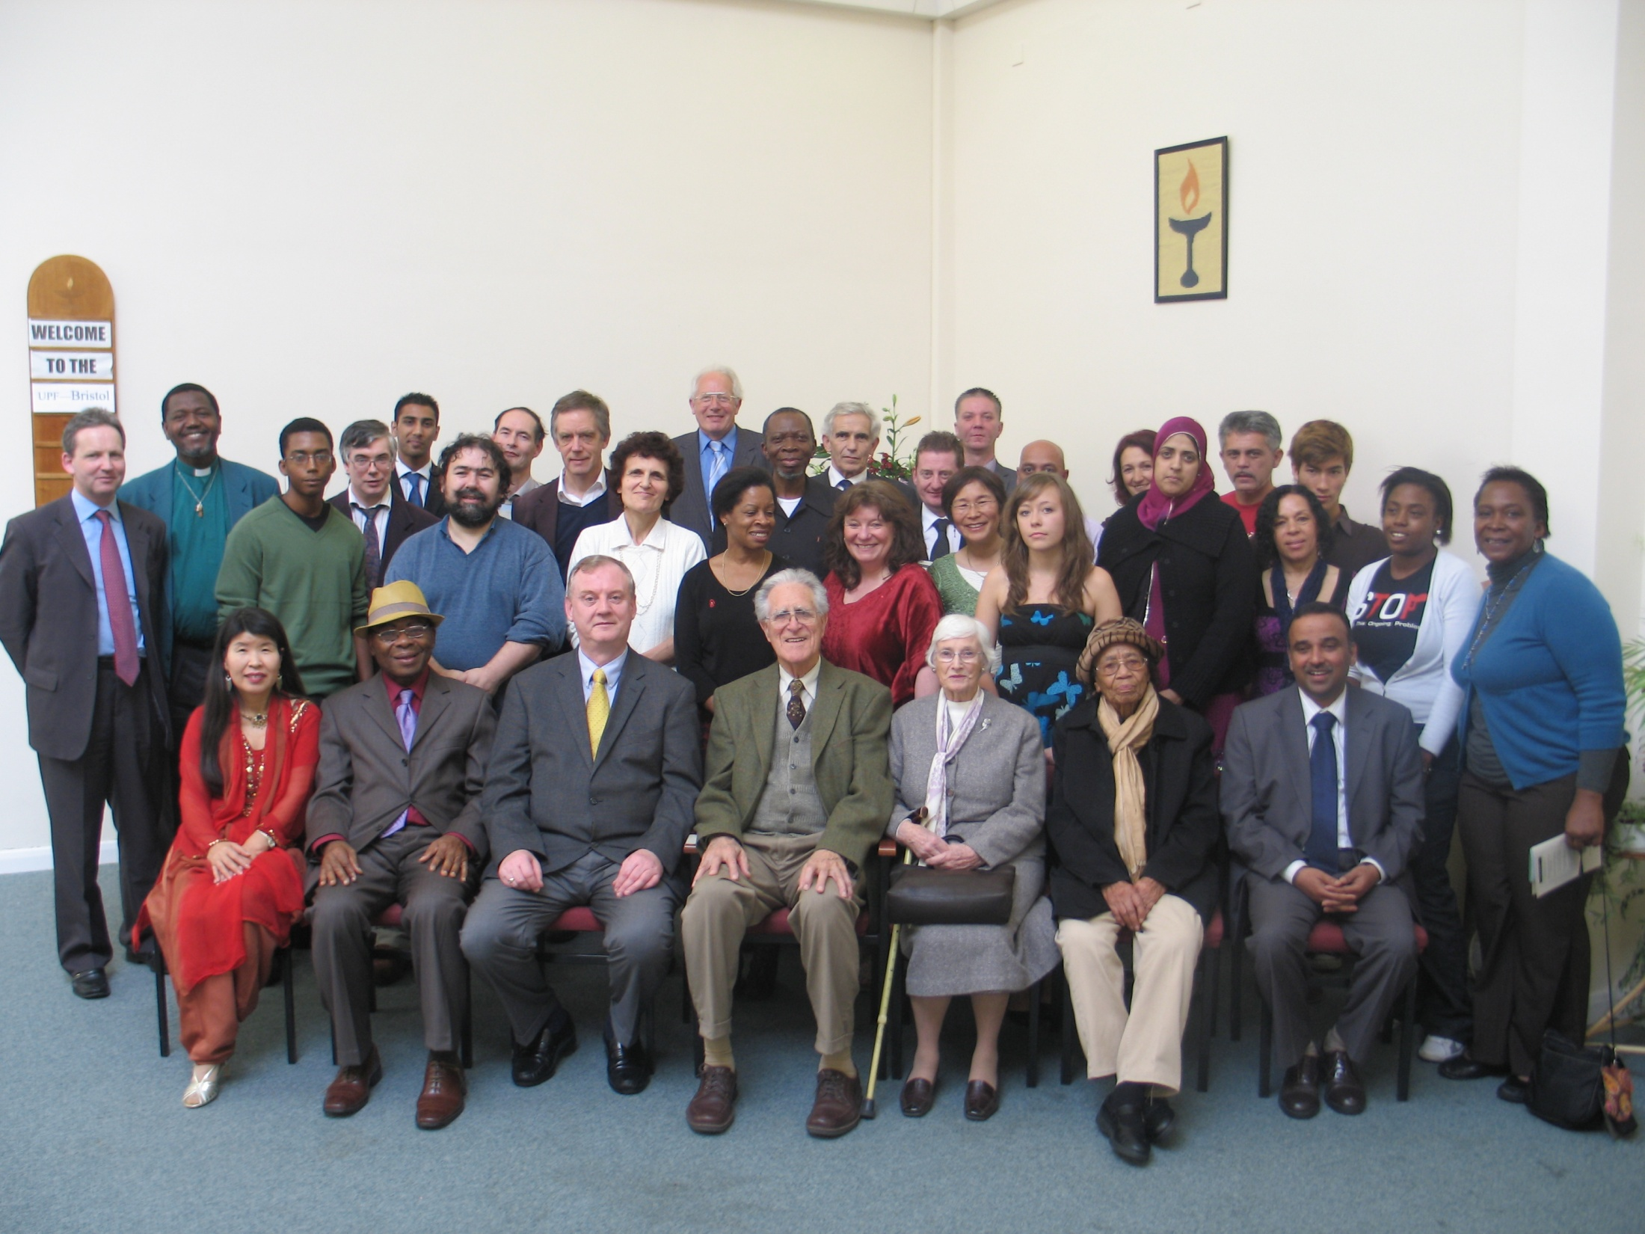
Bristol Showcases UPF

Slide 40
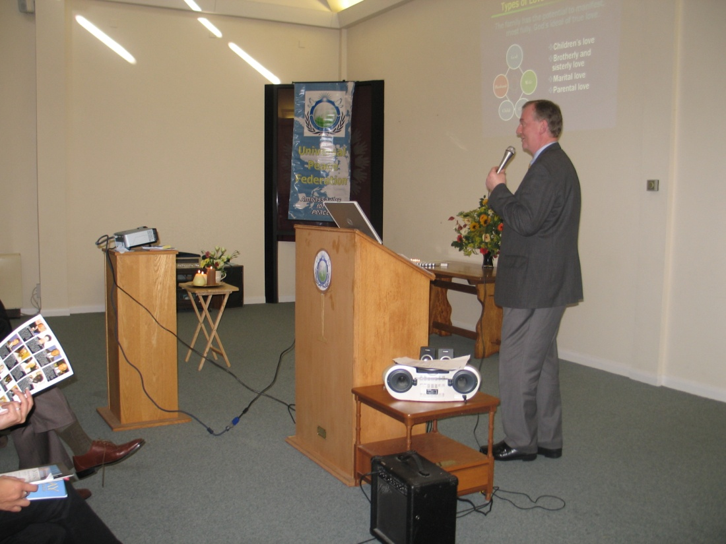


Bristol Showcases UPF
Oct. 2009

Slide 41

Rev. Dr. Marcus Braybrooke
‘Beacons of the Light’ Booklaunch Oct 16th

Slide 42

Rev. Dr. Marcus Braybrooke
‘Beacons of the Light’ Booklaunch Oct 16th

Slide 43

Guided Meditation by Karen Szulakowska

Slide 44


Slide 45

‘Forgiveness and Reconciliation’
Friends Meeting House, October 4th

Slide 46

Interfaith Water
Ceremony

Slide 47


Slide 48

Ambassador for Peace 2009
Tony Kempster
International Peace Bureau, Geneva

Slide 49

Ambassador for Peace 2009
Karen Szulakowska

Slide 50

Ambassador for Peace 2009
Haadia Saad

Slide 51

Ambassador for Peace 2009
Major Ret) Suryaparsad Upadhya

Slide 52

Ambassador for Peace 2009
Mr Mohammed Khokhar

