Slide 1
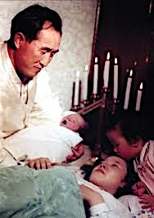




Session 39
Christ’s Return: When and How?
The sword
The state
Culture
Coercion
Ideas
The living Word of God

Slide 2

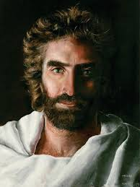

But about that day and hour no one knows. (Matt 24:36)
The Lord comes as a thief in the night. (Rev 3:3)
God does nothing without revealing his plan to his servants the prophets.
(Amos 3:7)
“the Son of Man shall come”

Slide 3

God will reveal the Lord’s coming to the faithful who are living in the light (1 Thess 5:4)
When will Christ return?
John the Baptist and his family
The wise men from the East
Simon and Anna
Shepherds watching the fields at night (Luke 1-2)

Slide 4
Age of Symbolic Parallels
Jacob Blessed by God and Goes to Haran
Abraham Departs for Haran
Isaac
Jacob
Jacob takes the birthright
Jacob's Family Departs Haran to Return to Canaan
Adam
Noah
Jacob visits Joseph
1,600
400
120
40
21
40
Age of Image Parallels
Period of Slavery in Egypt
Period of the Judges
Saul
David
Solomon
Period of the United Kingdom
Period of the Divided Kingdom
Period of Exile and Return
Period of Preparation for the Messiah
Abraham
Moses
Malachi
Jesus
400
400
120
400
210
400
Age of Substantial Parallels
Persecution in the Roman Empire
Regional Church Leadership
Preparation for Second Advent
Christian Empire
Divided Empire
Papal Exile and Return
Second Advent
Jesus
Augustine
Charlemagne
Luther
400
400
120
400
210
400

Slide 5

1917
Papal Exile
and Return
Preparation for Second Advent
Luther
Birth
210
400
1930

Slide 6

In what manner will Christ appear?
→ let’s check the Bible
He is coming with the clouds (Rev 1:7)
Difficult to accept
→ abandon Christianity

Slide 7

myth
reality
“clouds of heaven”
born of a woman
“chariot of fire”
born of a woman
NOBODY
Jesus, John the Baptist

Slide 8
reality
People denied Jesus came in the flesh AFTER HE ACTUALLY CAME IN THE FLESH (2 John 7]
The tendency to spiritualize is strong.
The Bible prophesies suffering.

Slide 9
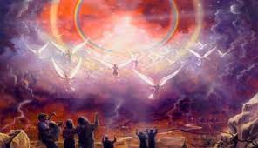
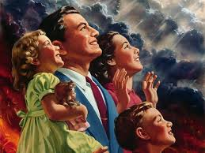
myth
reality
“Suffer many things, rejected by this generation”
“Will he find faith on earth? ”

Slide 10
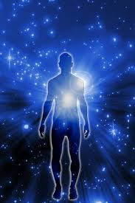
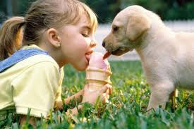
spirit
body
Spiritual salvation Physical salvation
Jesus cannot come in spirit only.
He comes as True Parents, to renew us spiritually and physically.

Slide 11
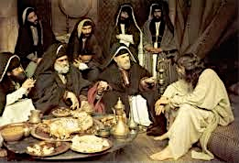
Distrust led to the cross
No OT prophecy of two comings
Trust: no need for a second coming
He has to come in the flesh.

Slide 12
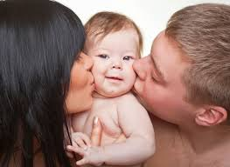
Individual
Spiritual
Family
Physical
Atonement is possible only for what is physically on earth

Slide 13


The meaning behind the Lord coming in the clouds
The Lord will come amid
crowds of faithful believers
The heavens
Higher value, higher love
Fallen people (Rev 17:15)
Crowds of people (Heb 12:1)

Slide 14
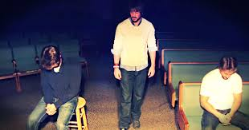
Would you have followed him?

