Slide 1

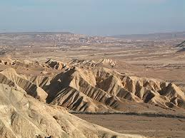
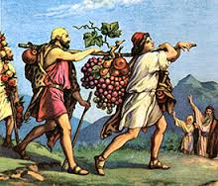
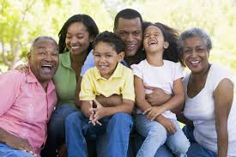
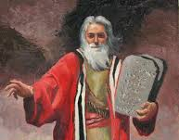
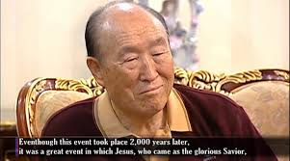
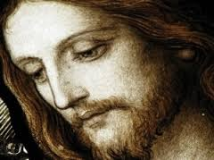
Session 31
Moses and Jesus 5
Failure of the second national course
Beginning the third national course

Slide 2
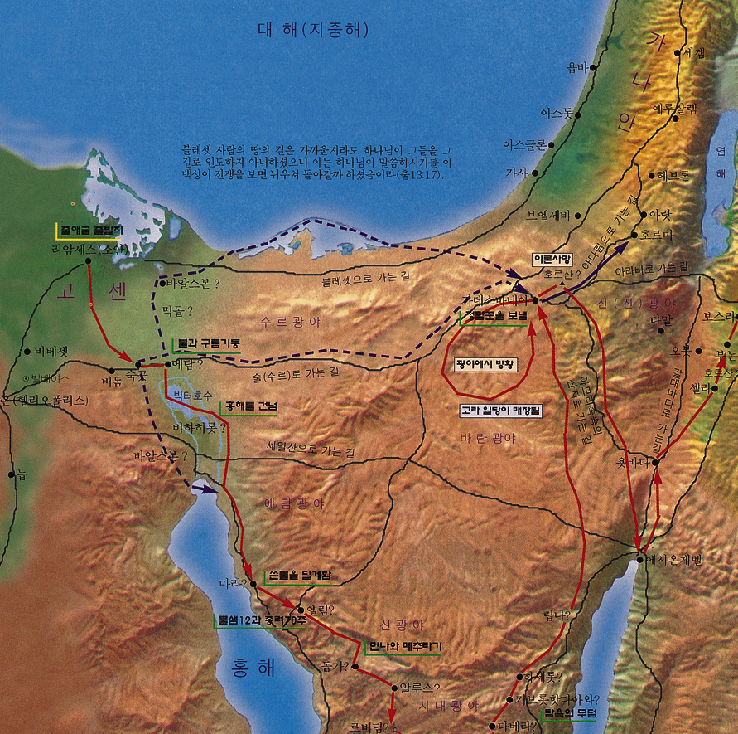

Foundation of Faith
40-years in wilderness
Kadesh-barnea
Second gen dedicated to Tabernacle
Foundation of faith for third national course
Departed from Kadesh-barnea

Slide 3



Foundation of Substance
Enter Canaan
God
Honored Tabernacle
The Foundation of Substance
Moses
Israel
Follow without complaint

Slide 4
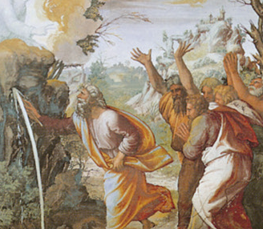
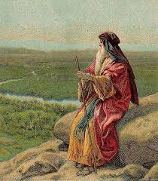
To indemnify the people’s complaining…
Bring water from rock
Moses’ mistake—anger
Hit the rock not once, but twice
Moses had to remain in the wilderness

Slide 5

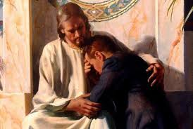
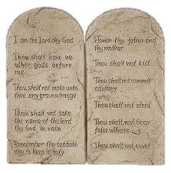
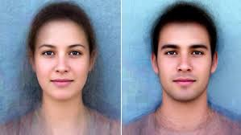
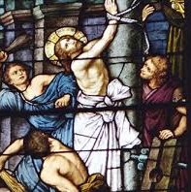
The Rock is Christ
1 Cor 10:4
Rock = root of Ten Commandments = Adam and Eve
Strike once = bring dead Adam to life as Jesus, the water of life
Strike again = a condition for Satan to strike Jesus

Slide 6
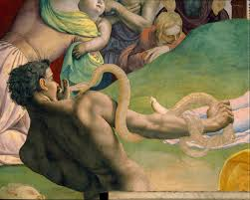
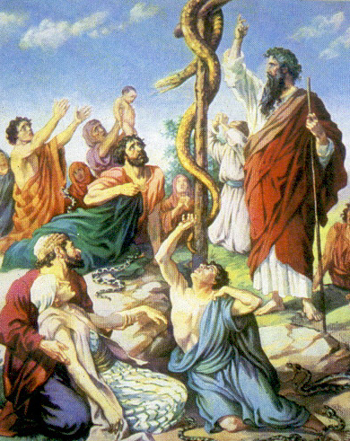
Disbelief: Death by fiery serpents, Num 21:6
Fiery serpent = Satan
Repentance after disbelief: Salvation by bronze serpent on a pole, Num 21:9
Bronze serpent on a pole = Jesus on the cross
Disbelief in Jesus → death on cross, and salvation to all who believe in him

Slide 7
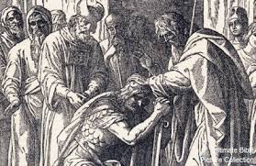
Moses called Joshua to lead Israel
The Foundation of Substance centered on Joshua
'No man shall be able to stand before you all the days of your life; as I was with Moses, so I will be with you; I will not fail you or forsake you. ... Only be strong and very courageous, being careful to do according to all the law which Moses my servant commanded you; turn not from it to the right hand or to the left,
that you may have good success wherever you go.' Josh 1:5-7

Slide 8
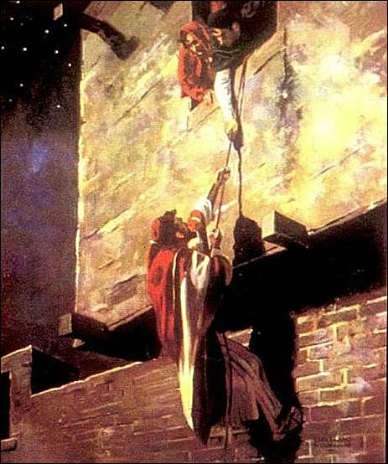
Joshua sent two spies into Jericho
The prostitute Rahab helped them escape.
She is an ancestor of King David and Jesus.
The spies reported faithfully—we can get victory.

Slide 9
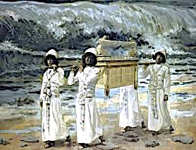
A 3-day journey to the Jordan River
They followed the Ark across the Jordan
Separation of good and evil before the Son and Holy Spirit
Forgiven saints will enter Canaan

Slide 10
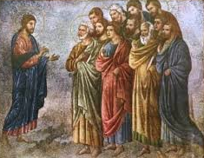
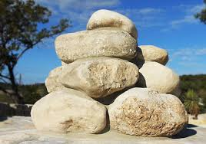
An altar of 12 stones
Unity of Jesus’ 12 disciples
Conducted circumcisions
Separate from Satan before entering Canaan

Slide 11
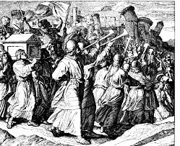
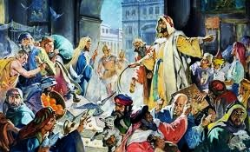
Priests with the Ark of the Covenant
Circled the city 7 times
Jesus tears down the walls and to build heaven on earth

Slide 12
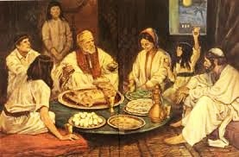
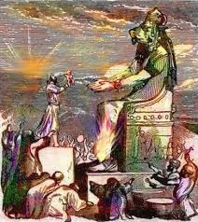
Joshua led Israel into the Promised Land
National expectations completed
The Messiah could come once they built a foundation to fight satan’s nations
The Israelites gradually turned faithless

Slide 13
Some Lessons from Moses' Course
1. God has been guiding human history with one absolute purpose
2. The achievement of God's predestined Will depends on the human portion of responsibility
3. God does not intervene in our responsibility but acts upon the actual result we bring.
4. The greater one's mission, the greater will be the test one will face.

Slide 14
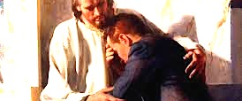
Dealing with hardships, temptations and tests
Don’t get angry
Don’t worry
Be grateful
Raise up your successor and accept God’s vision
This gives insight into the life, death and resurrection of Jesus

